Slide 1
Astronomical Data Archives Workshop
August 2019, AAO/MQ Sydney
Presented by Greg Sleap, Curtin University/MWA
Notes:
Housekeeping: bathrooms, emergency exits….

Slide 2
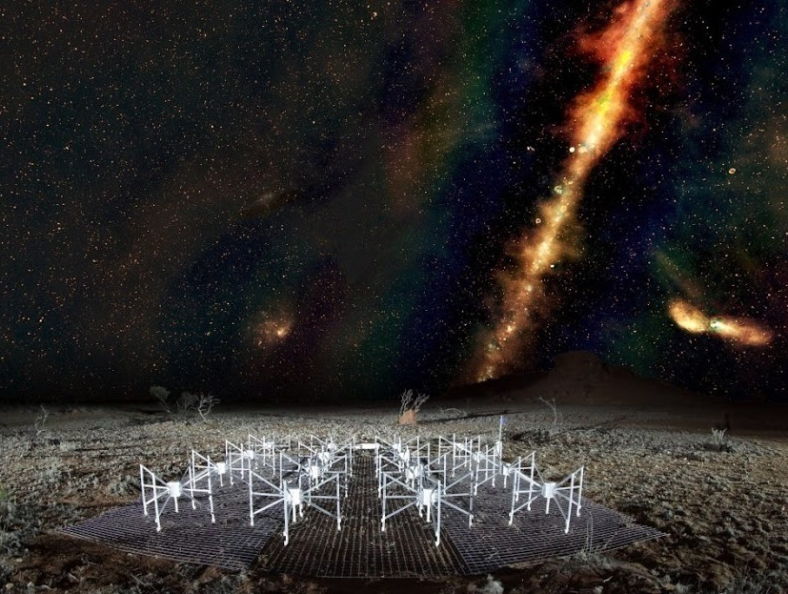
About the MWA
Operating since mid 2013
International collaboration of 20 led by Curtin University
One of four SKA Precursor telescopes
70-300 MHz, 30.72 MHz instantaneous b/w
256 dual polarisation tiles (128 at a time)
32 PB of raw voltages & visibility data
Image: credit Natasha Hurley-Walker/GLEAM. Foreground image John Goldsmith

Slide 3
About the MWA
Notes:
>20 partners from half a dozen countries: Aus, USA, China, Japan, Canada, NZ

Slide 4
Services
Telescope operations
Archive of MWA Data
Raw correlator visibilities
High time resolution voltages
Pre-processing
RFI flagging
Calibration
MWA ASVO portal (Public and proprietary)
Search / Convert / Pre-process / apply calibration / Download correlator data
VO interfaces (TAP)
Command-line client
Single sign on via AAF/eduGAIN/ORCID/UnitedID
MWA Project services
Wiki / Mailing lists / Collaboration management

Slide 5
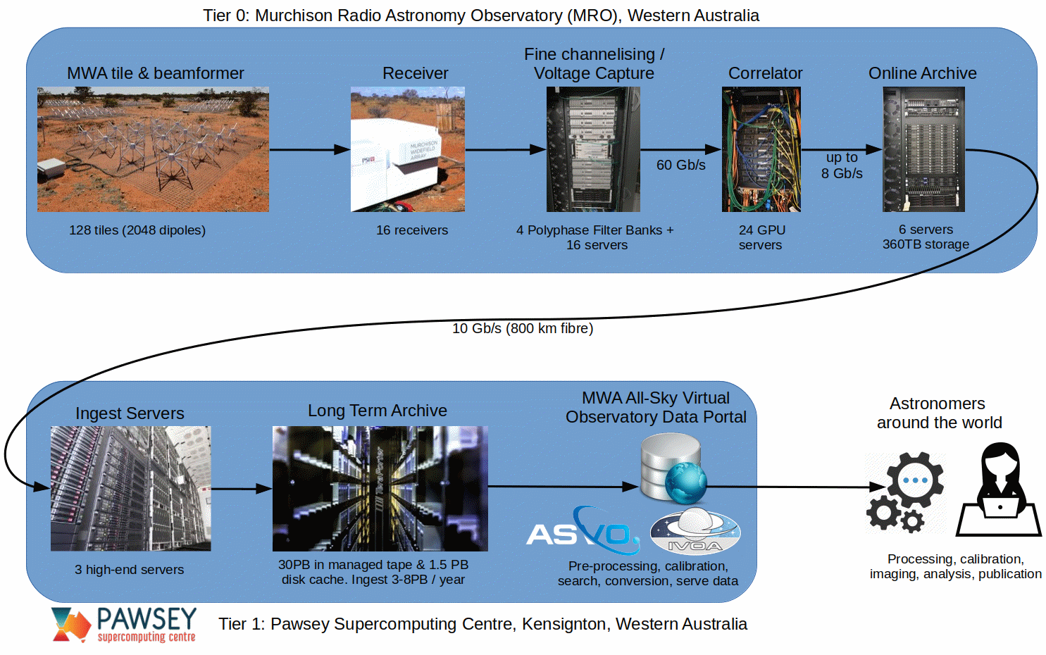
MWA Data Flow (now)

Slide 6
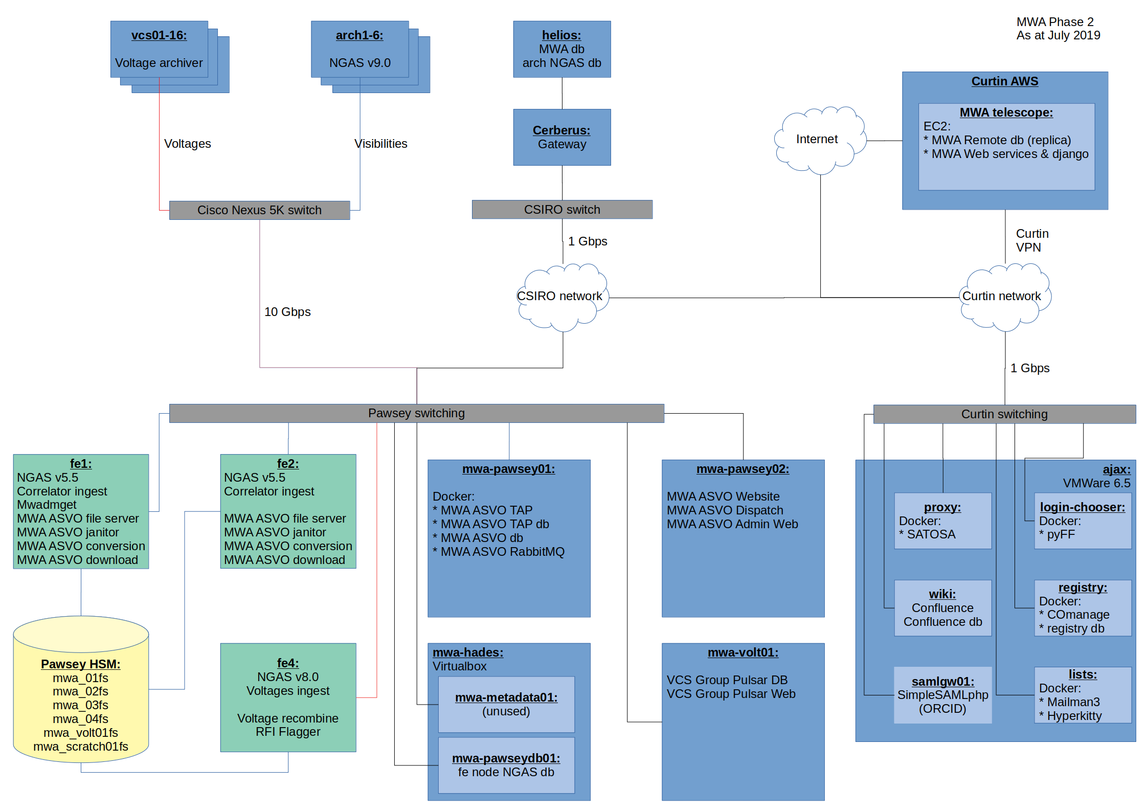
MWA Architecture
MRO

Slide 7
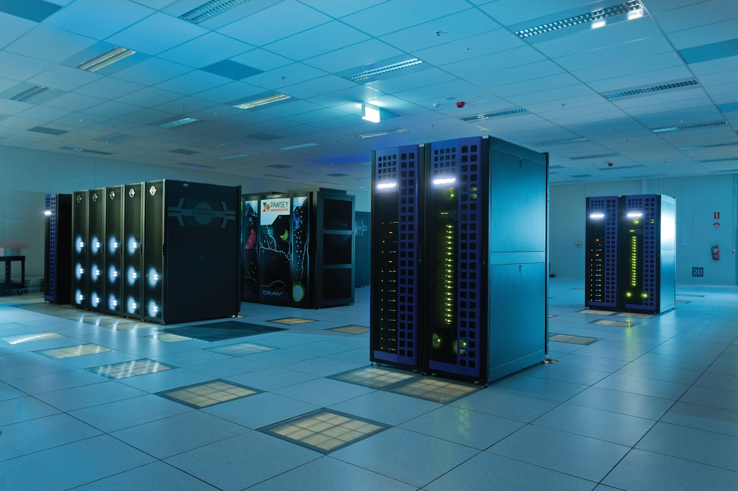
Data Archive
32+ PB stored
34,000,000+ files
SGI (HPE) DMF HSM
Ingest at up to 80 TB per day
POSIX-based archive software (NGAS)
1.5 PB disk cache
3 PB of “zero-watt” disk storage
40 PB out of 63 PB of robotic tape library 7 – 10 TB per tape
x2 – duplicated libraries for redundancy
Notes:
The data is then sent alllll the way to Perth using the NBN network, and gets stored at the Pawsey supercomputer where astronomers can access it. We have 31 petabytes of data….which is over 7 million DVDs’ worth !

Slide 8
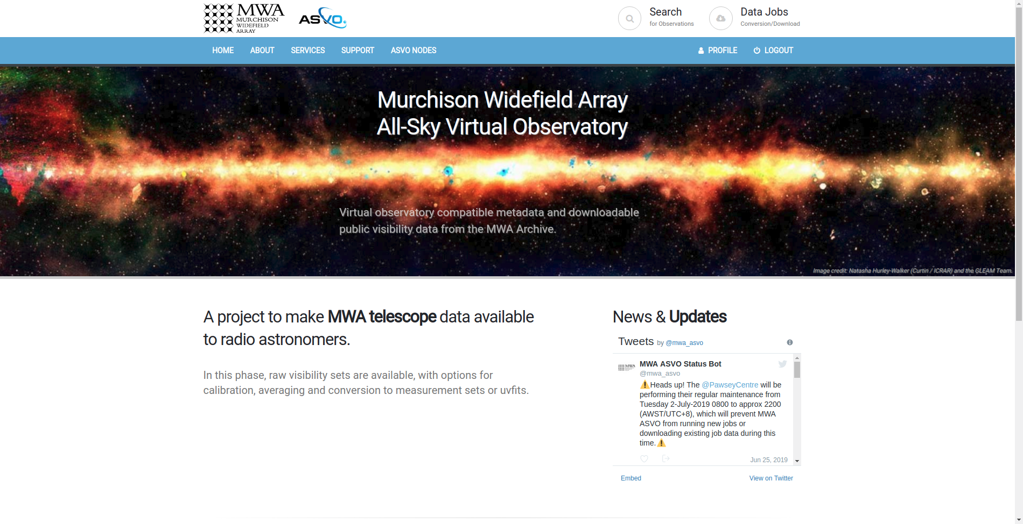
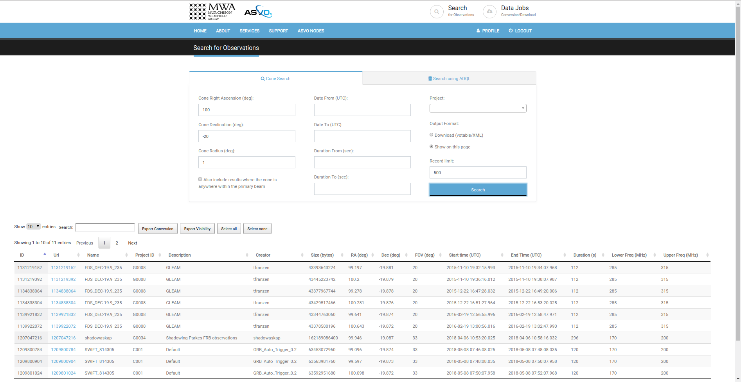
MWA ASVO

Slide 9
MWA ASVO Architecture
VO services
TAP db
MWA metadata db
MWA Archive
TAP clients
Job Queue
Staging/Pre-processing
Web Site
Web clients
API
Worker
Servers
Workers
Workers
Web services
API clients
MWA ASVO db
Data
Downloads

Slide 10
MWA Software Stack
Ubuntu / Centos / SLES / RHEL
Telescope operations and M&C
Python 2.7
Apache2
Postgresql 10
Java/Raspbian/Icinga/Observium/graphite, etc,etc
On site and AWS
Data transport and archive ingest
Python 2.7
NGAS
Pre-processing
Python 2.7
C/C++, CUDA, MPI

Slide 11
MWA Software Stack
Identity Management & project services
Confluence wiki
Mailman3 + Postorius + Hyperkitty
COmanage
pyFF
SATOSA proxy
SimpleSAMLphp
Postgresql 9.6
Nginx
Docker
VMWare

Slide 12
MWA Software Stack
MWA ASVO
Python 3.6
aiohttp
jinja2
asyncpg
pySAML
pyvo
Postgresql 9.6
RabbitMQ
CASADA VO Tools (Tomcat)
Docker
Django

Slide 13
Challenges
Multiple sites to manage: MRO, Curtin, Pawsey, AWS
Relationship management: Pawsey, CSIRO, Curtin & AARNet
Menagerie of hardware, grown organically
Aging hardware
Pawsey tape system staging & reliability
HPE support for DMF/cxfs limited to old SLES 12 (~2014) ☹
FE nodes are an OLD SLES (v11!)
Data management- ‘cold’ vs ‘hot’ data
Storing raw data vs science data (flexibility vs efficiency)
Pawsey Monthly maintenance
Even with fat pipes, moving large data volumes is hard
Lots of existing Python 2.7 code to migrate
Shifting focus from MWA project to public users
More data quality metrics; barriers to entry

Slide 14
Future work…
Improved VO services (TAP, SCS) and better web search
Minimise metal! Migrate all non-data intensive servers to AWS
Web servers / VO / Databases / Identity Management / etc
Migrate to latest NGAS version
Commission new FE nodes and storage at Pawsey
Standardise more on software/hardware where possible
Increased allocation in Pawsey (manage a cap)
Data lifecycle management
Improved download service
Migrate all Python 2.x code to Python 3.x
Single sign on integration with rest of ASVO nodes
Astroquery implementation
Move to 256 tiles (4x correlator data rate, 2x voltages)
Move to using 100 Gbps link and Curtin cache MWA transport
Enable MWA ASVO to use the 3PB of cache at Curtin
Investigate RFI flagging jobs using AWS
More work on FAIR / DOI

Slide 15
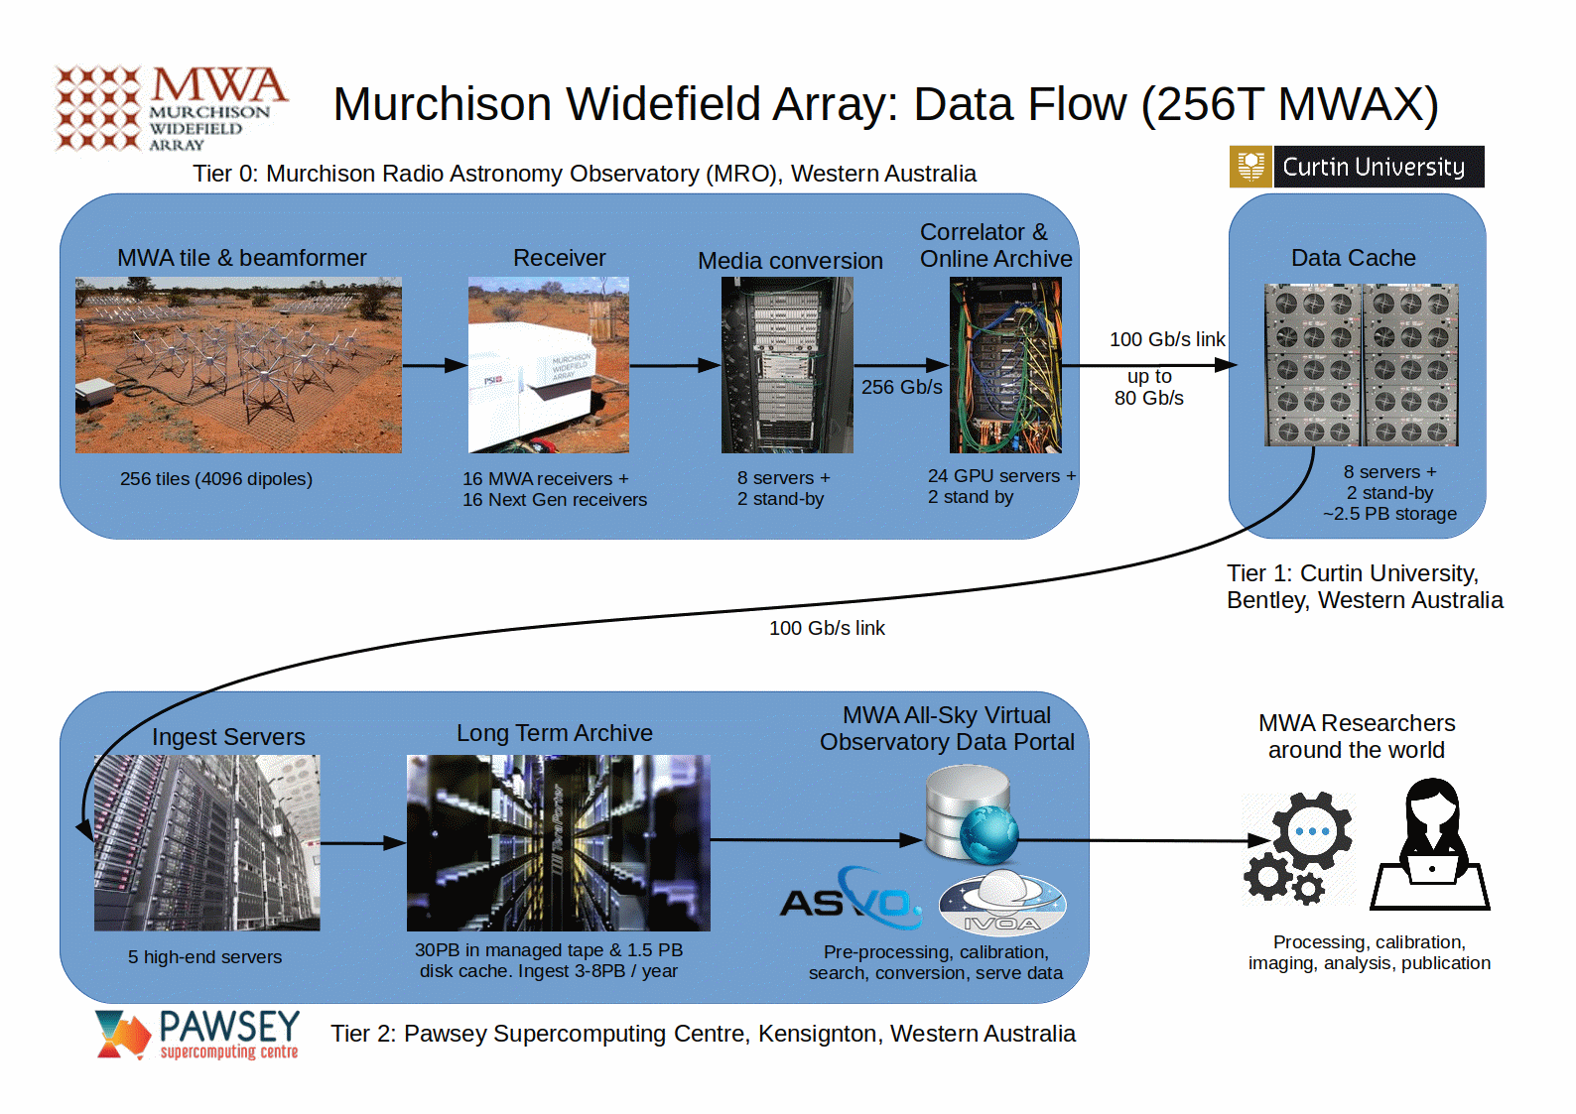
MWA Future

Slide 16
Thank you
Greg Sleap
MWA Data Manager
greg.sleap@curtin.edu.au
http://www.mwatelescope.org https://asvo.mwatelescope.org
@mwatelescope
Murchison Widefield Array
We acknowledge the Wajarri people as the traditional owners of the MRO site.

