Slide 1
China-VO Science Platform
Changhua Li Dongwei Fan Chenzhou Cui
Chinese Virtual Observatory (China-VO)
National Astronomical Observatory of China
Notes:
I am glad to have the opportunity to introduce our team’s work. I am from China-VO group, national astronomical observatories of China, Chinese Academy of Sciences

Slide 2
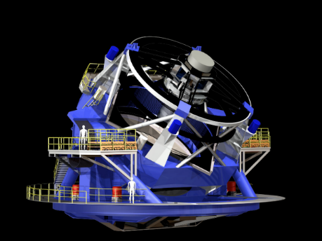
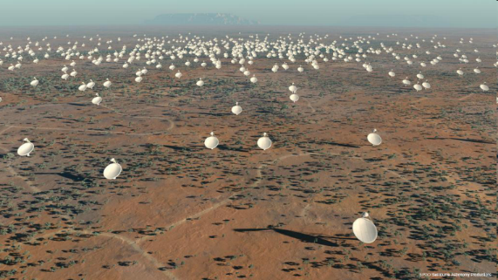
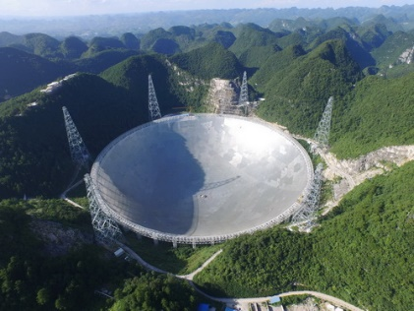
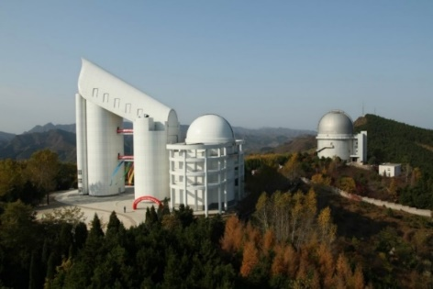
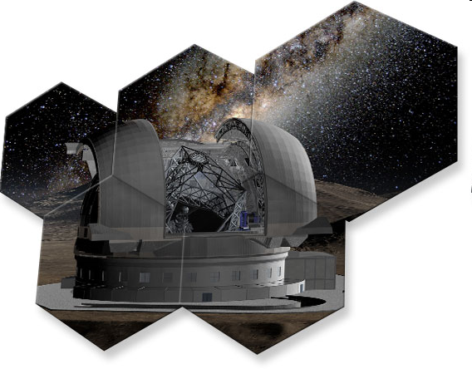
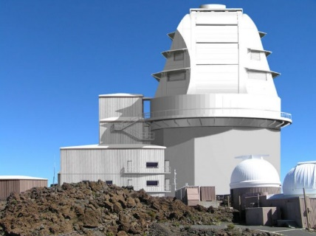
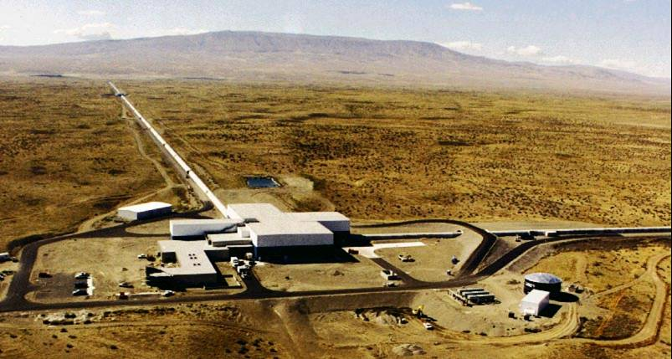
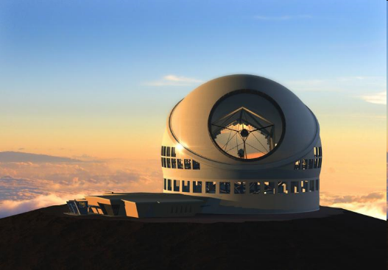
Heroes behind the Big Data
Notes:
I think these telescope are familiar to you, even though they are built for different astronomical research goals, but the data is their common product. In the near future, a large scale data will be produced.

Slide 3

Data
Notes:
Big data gives us many new challenges in storage, computing, transportations and Interoperability. on one hand , personal computer can’t provide enough computing and storage ability, on the other hand, data migration is very difficult by internet. They will change our traditional research mode.

Slide 4
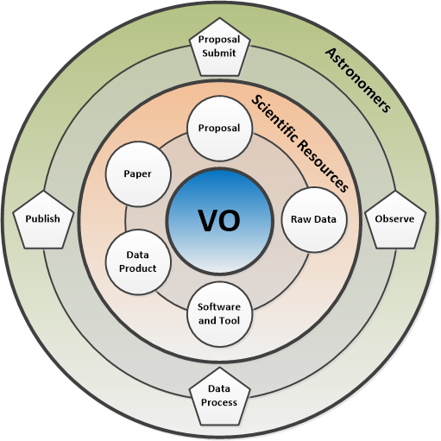

A Whole Lifecycle Science Platform for Astronomy
Notes:
As just mentioned, data is the foundation of astronomical research. So, we proposed a idea of whole lifecycle management of astronomical data. and a online research platform has been set up.

Slide 5
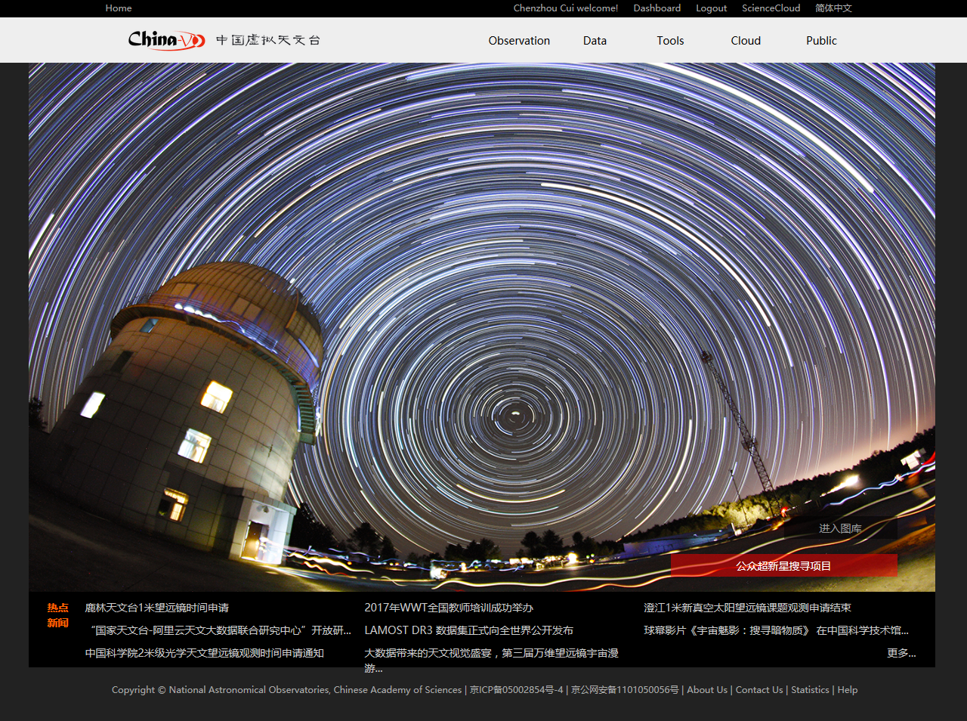
China-VO Science Platform
Notes:
China-VO science platform is a cyber-Infrastructure for Astronomy Research.

Slide 6
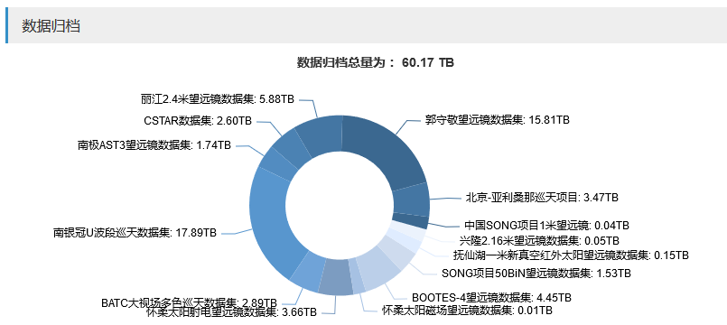
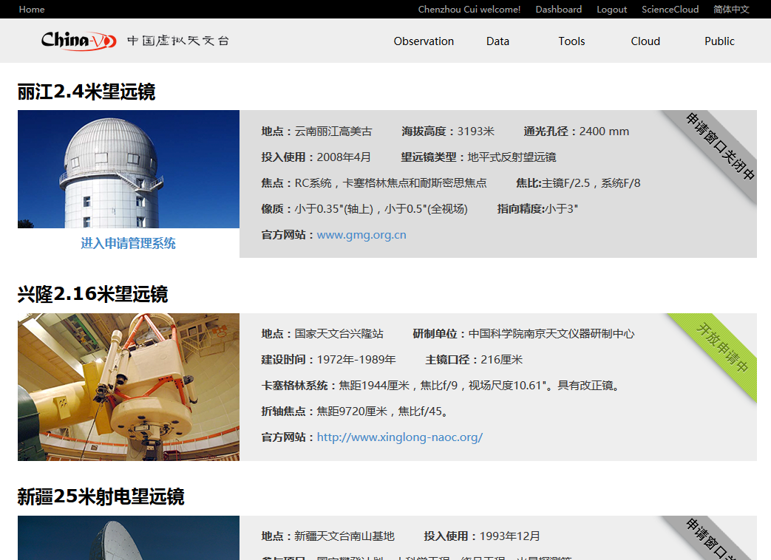
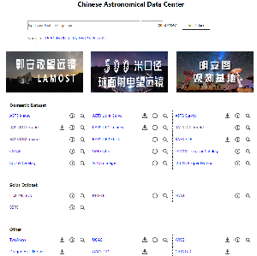
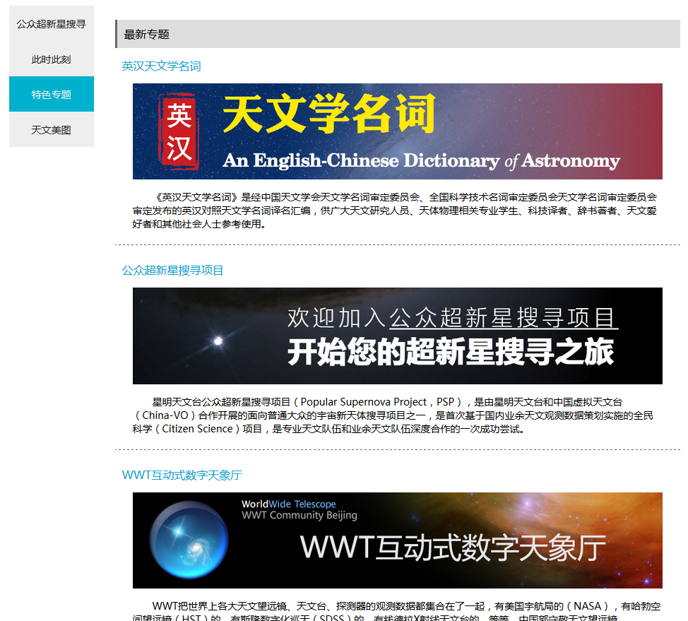
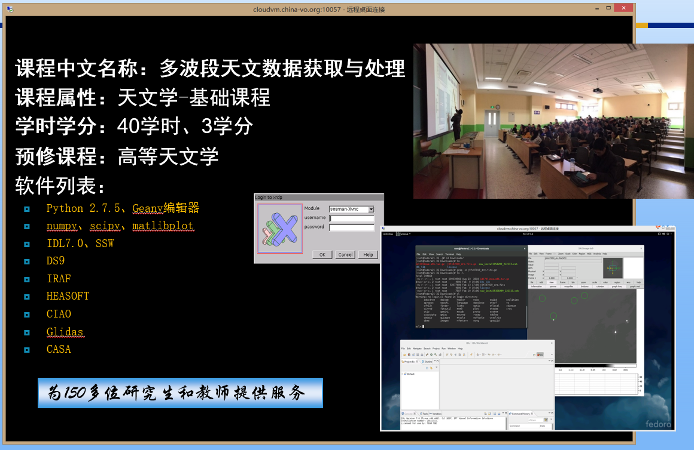
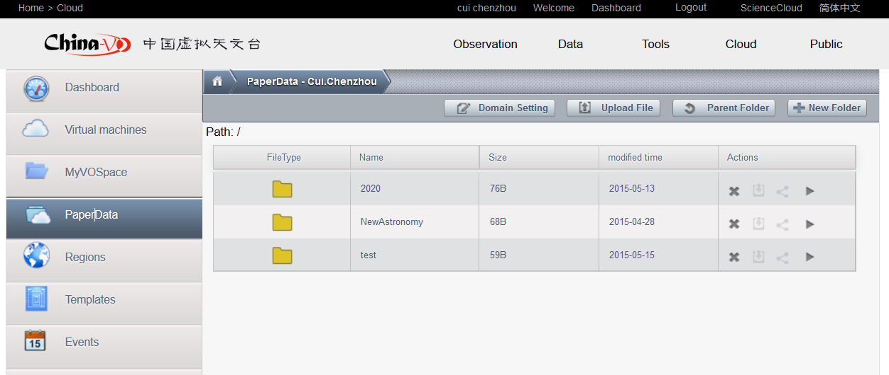
Main Function Modules
Observation
  Telescope Proposal Submission and Management
    2.4m, 2.16m, radio telescopes, public telescopes
    TAP (Telescope Access Project)
Data
  Virtual Observatory, Seamless astronomy
Tools
  Selected VO tools and software packages
Cloud
  Pre-installed data processing and analyzing environments
  China-VO paperdata, Cloud based storage
Public
  Public Supernova search Project (PSP)
  China-VO specials
    Observatory live video streams
    Astronomical Dictionary
    CosmoStation
    Gallery
    ……
Notes:
Cloud computing system is an important part of this platform, which aims to integrate geographical distribution computing resource through network and to provide computing and service on demand based on virtualization technology.

Slide 7
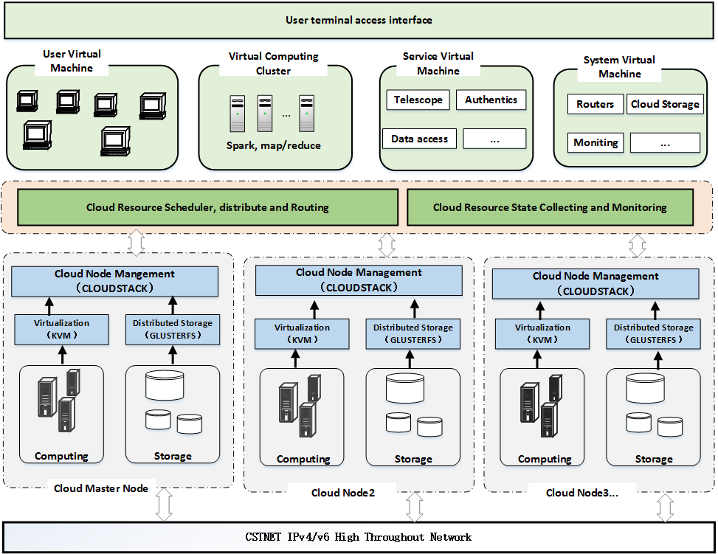
The Architecture of China-VO Cloud
Notes:
This picture shows the architecture of China-VO cloud system. The low layer is network Infrastructure and hardware resources. Then is the software system.

Slide 8
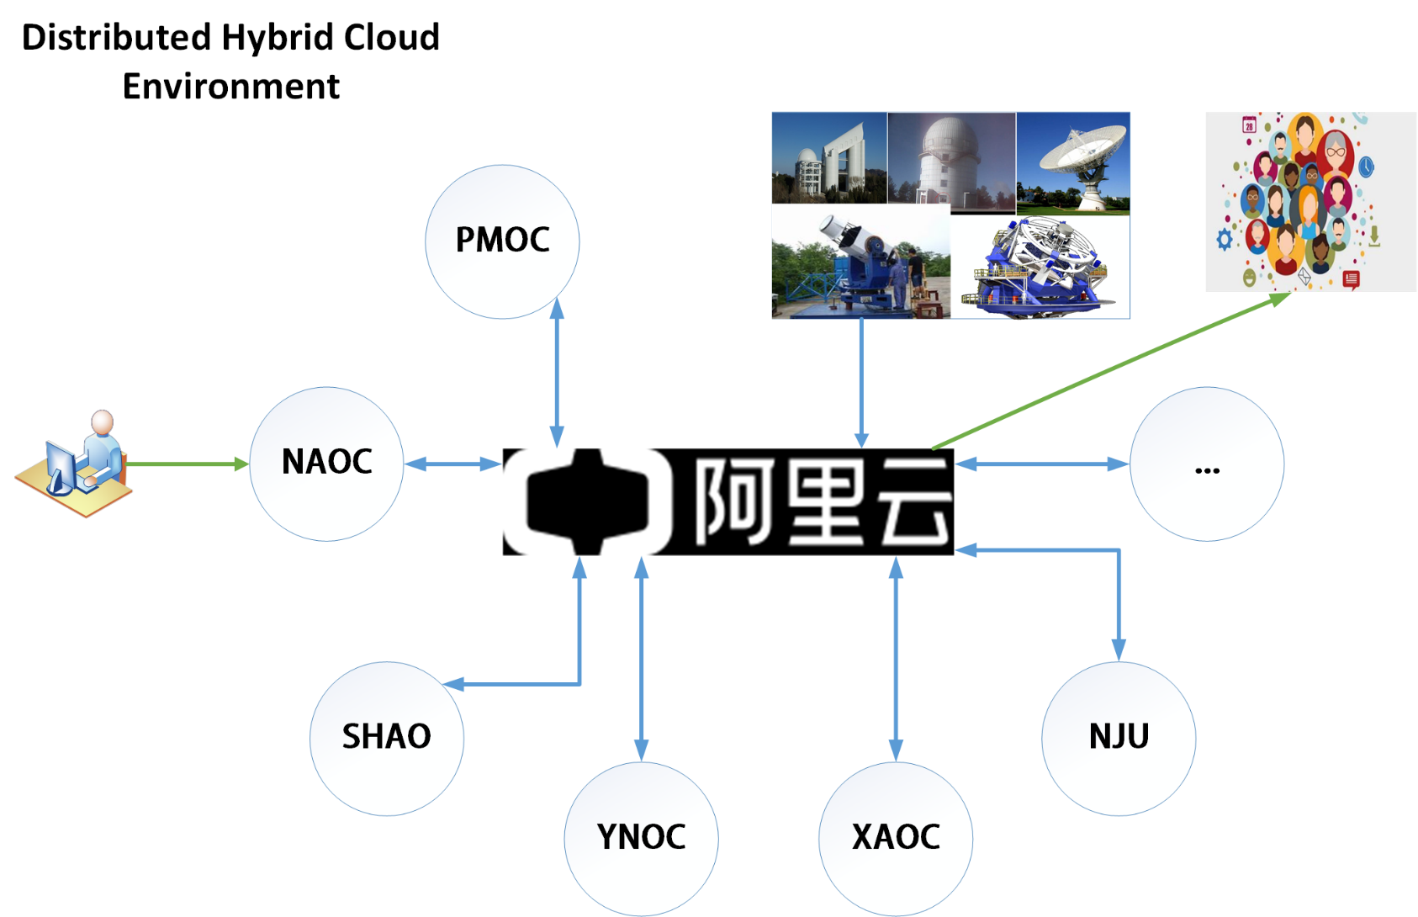

Regional Cloud Nodes Distribution
Notes:
So, this forms a public and private hybrid distributed cloud computing environment. These cloud nodes can be divided two level, public cloud and private cloud. In general, Public data was archived in Alibaba cloud and released to the world. Astronomer’s private data can be saved in private cloud.

Slide 9

Cloud Infrastructure

Slide 10
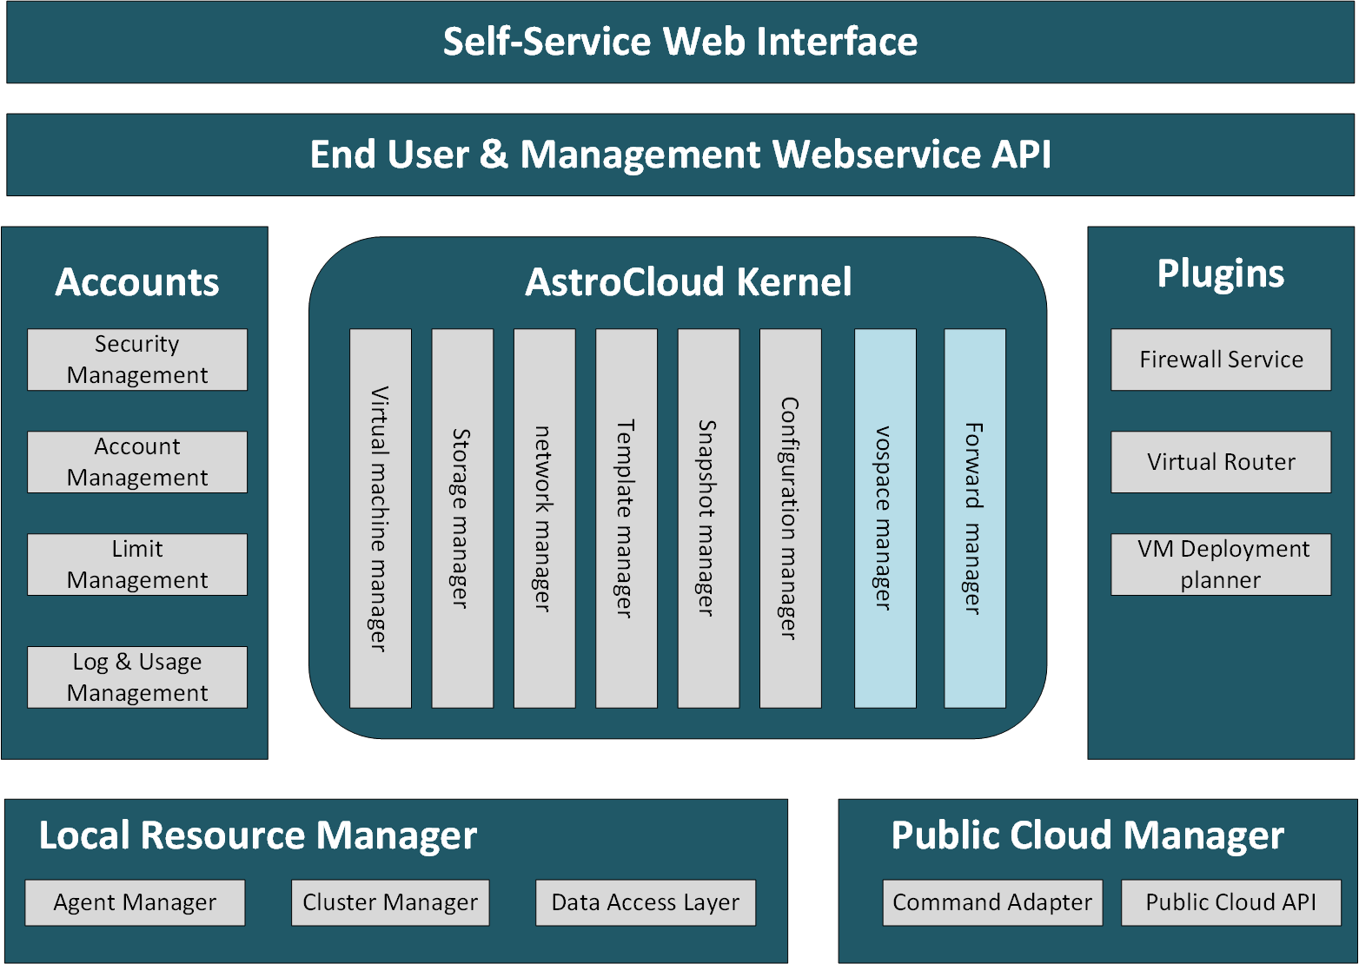
Regional Cloud Node Modules
Notes:
With reference to Cloudstack, we have extended the functional modules of cloud nodes.

Slide 11

The key software stack
China-VO Customization Web Interface
JQUERY+AJAX+JSON
JAVA+SPRING+MYSQL
UI
CS 4.0
（NFS, Samba,
Iptables,…)
API
CentOS+KVM
Management server
Notes:
Cloud node component was based on CloudStack, which is an open source cloud operation system. A regional cloud node contains management server and computation server(agent server)

Slide 12
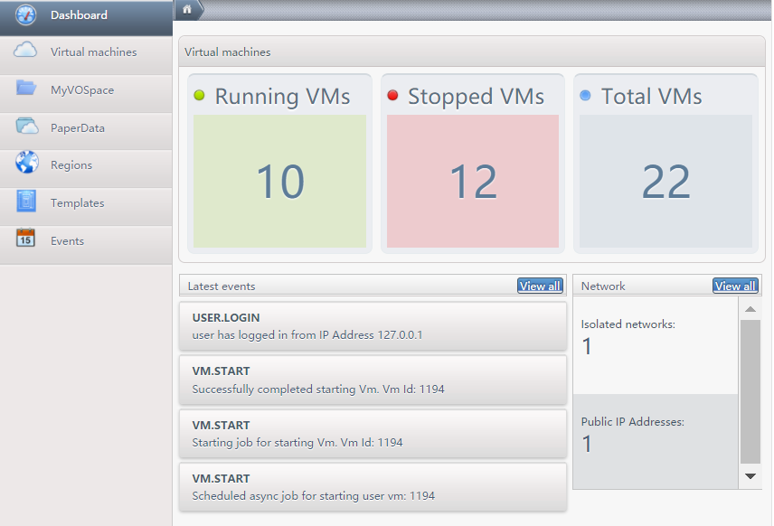
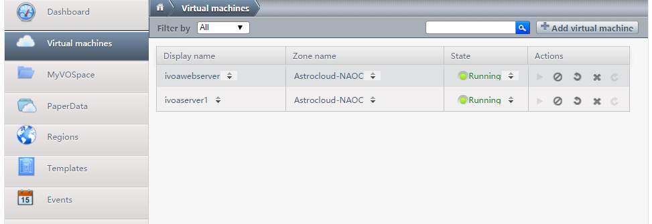
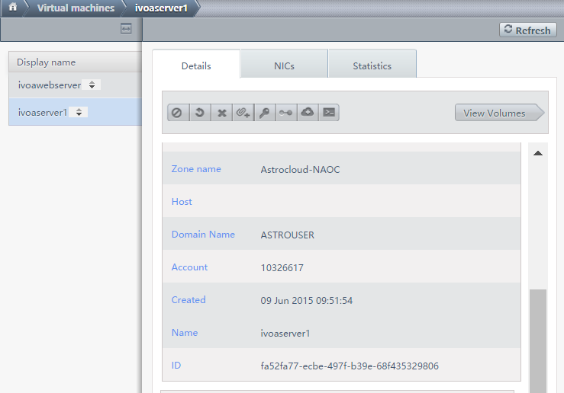

Slide 13
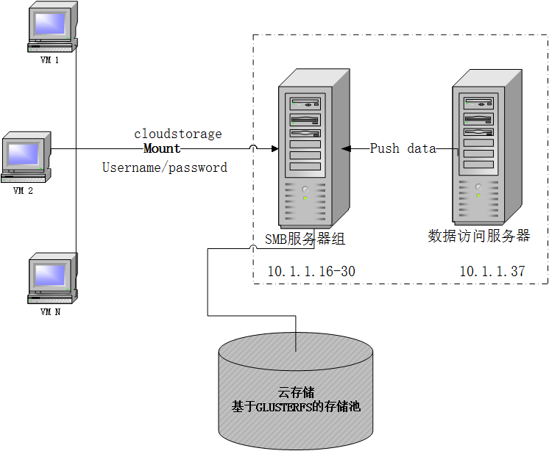
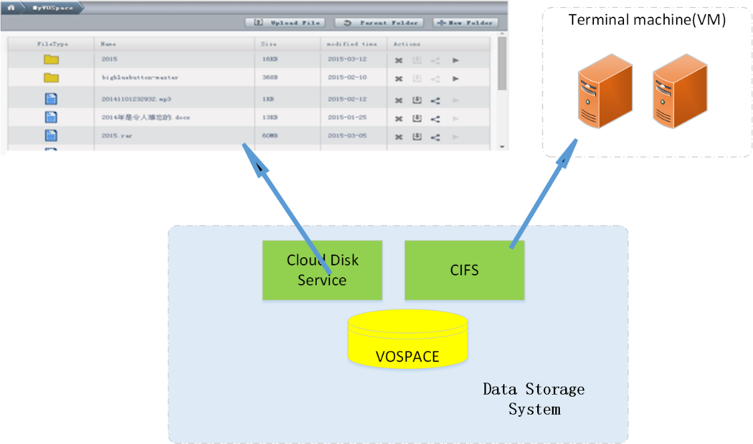
Vospace & PaperData
The distributed storage
  Glusterfs, CEPH

Slide 14
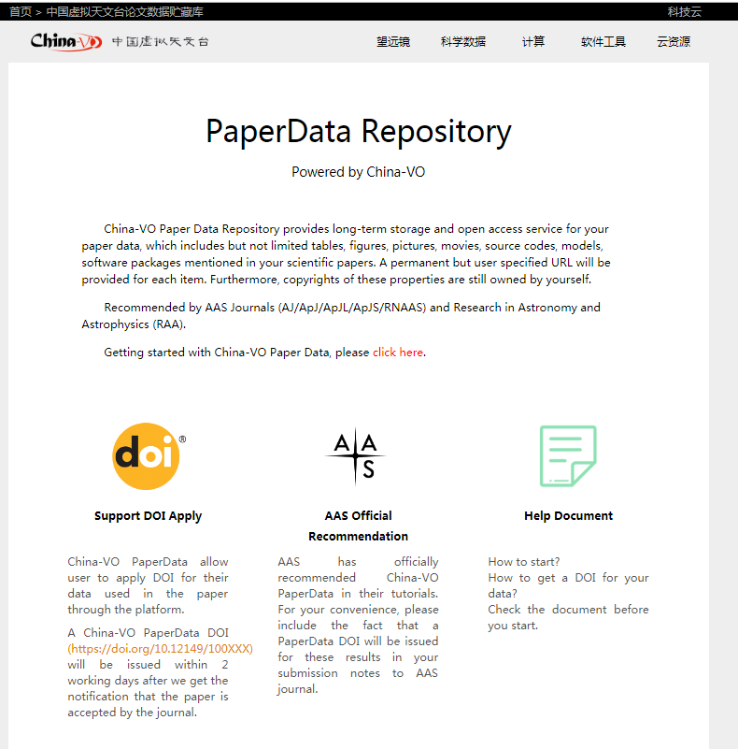
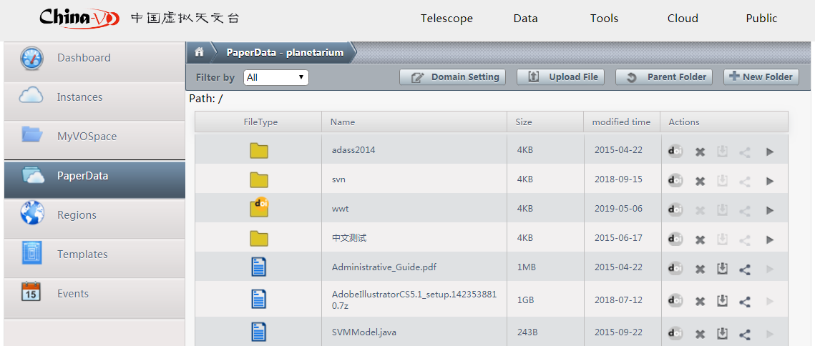
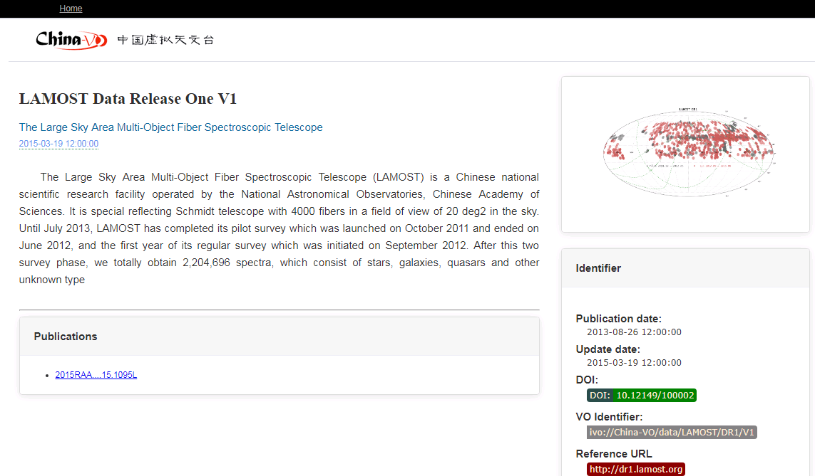
PAPERDATA+DOI
Notes:
Just two months ago, we released a new PAPERDATA service.

Slide 15
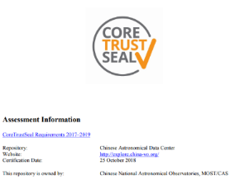
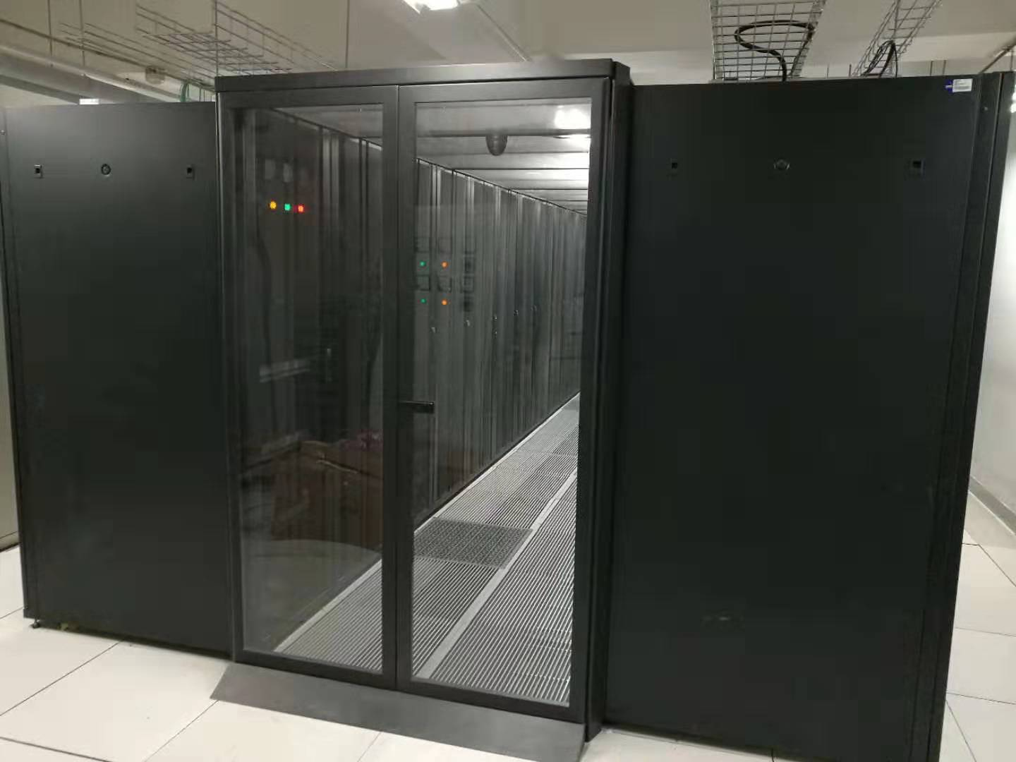
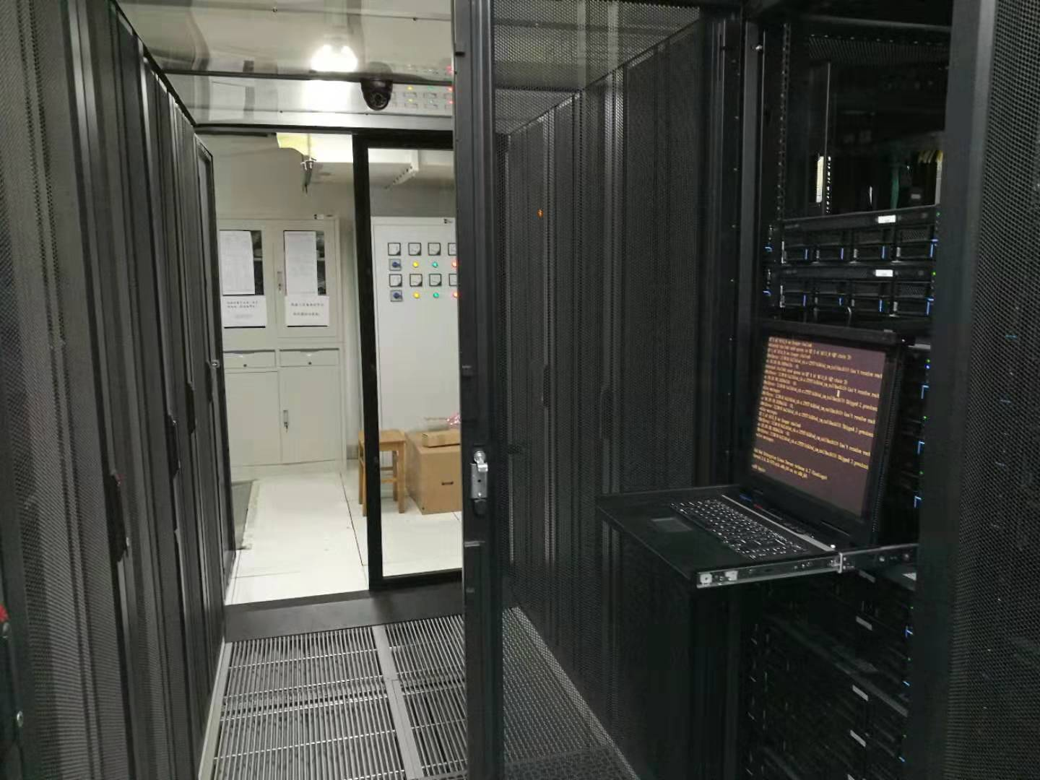
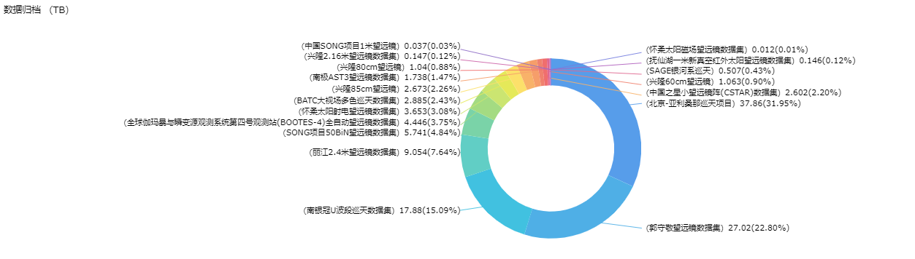
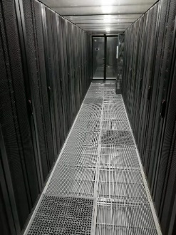
Chinese Astronomical Data Center
Domestic datasets：21

Slide 16
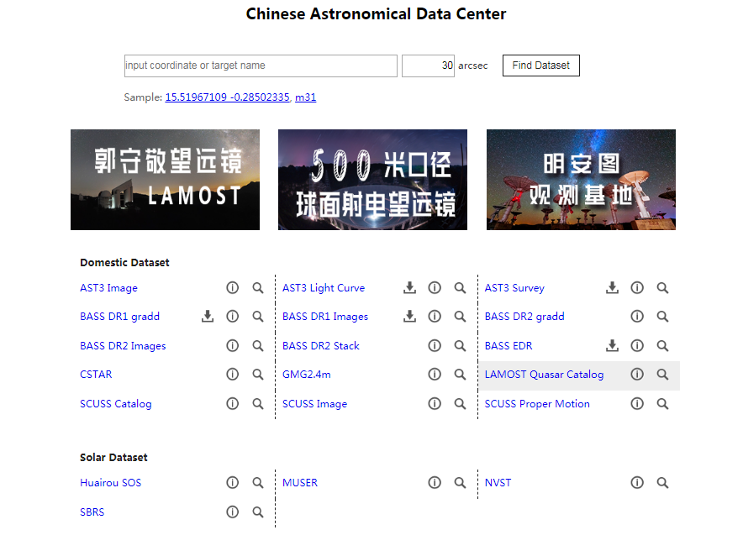
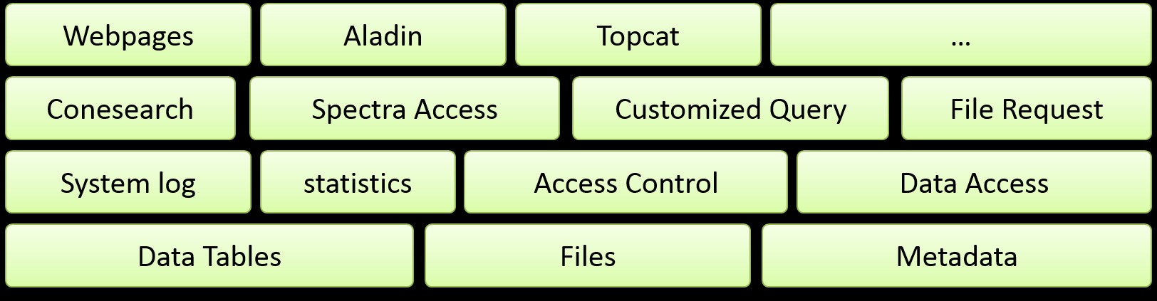
Science Data Release System

Slide 17
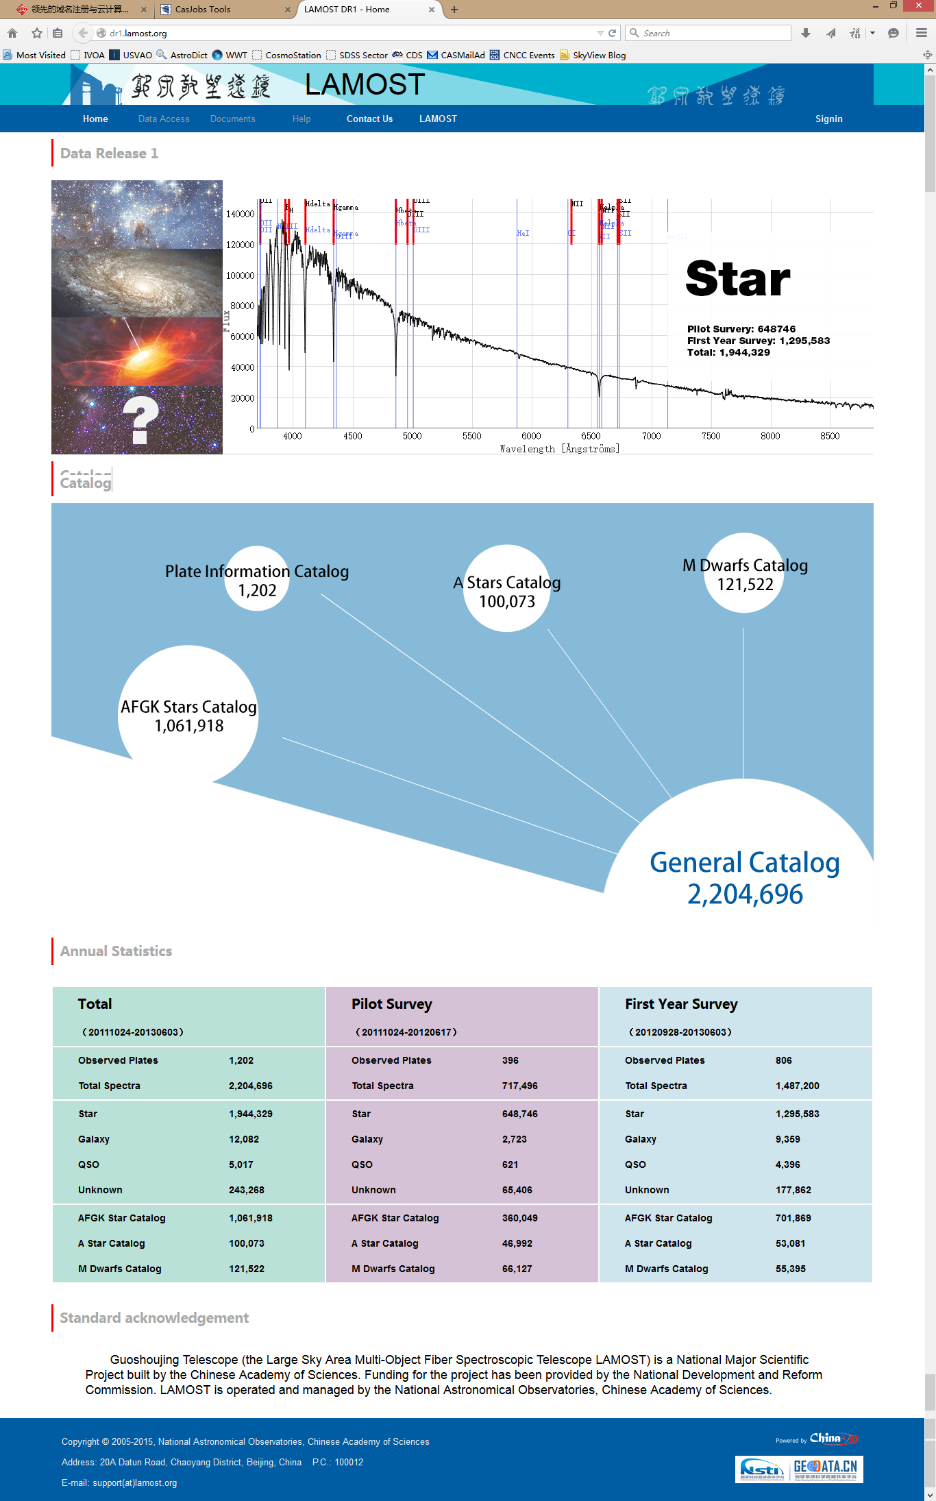
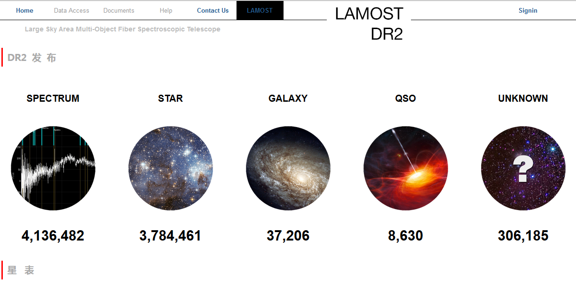
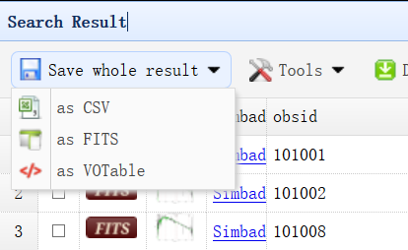
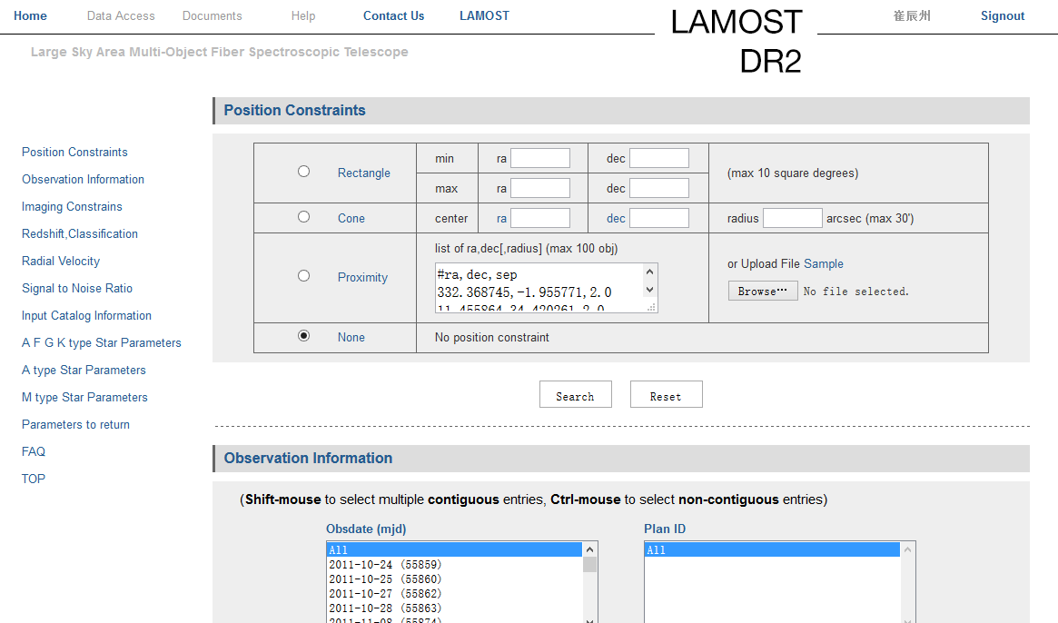
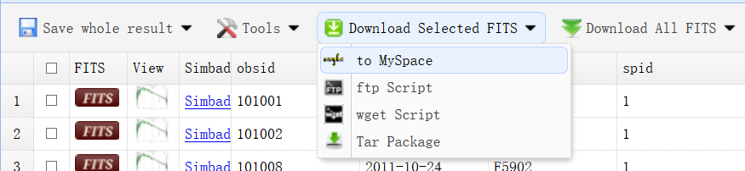
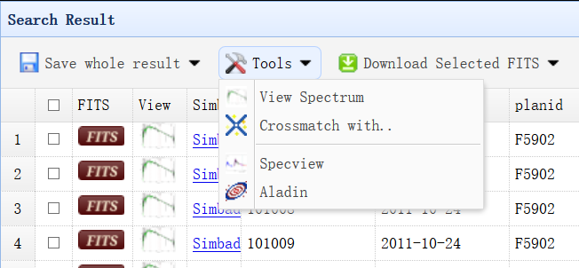
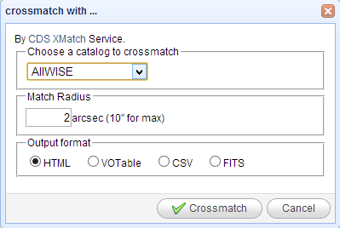
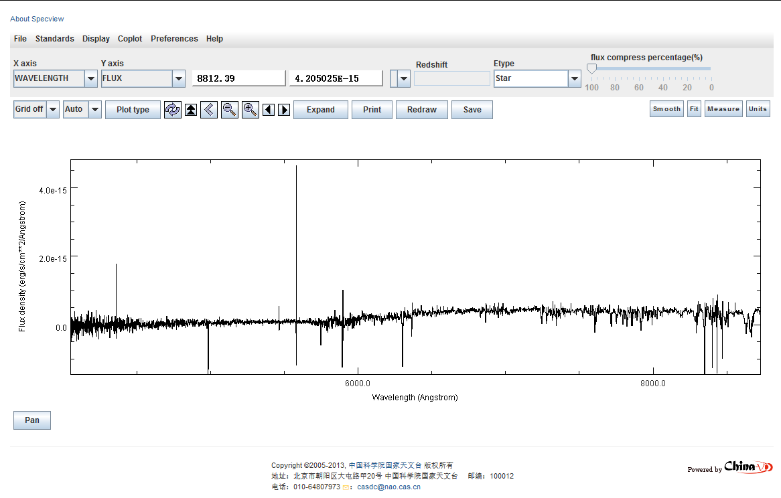
LAMOST Data Release System

Slide 18



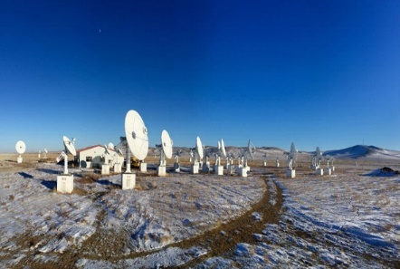

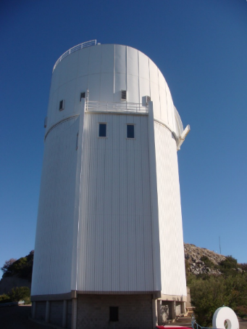

FAST
LAMOST
Solar Radio-MUSER
银河系三维结构研究
Solar magnetic research group
…
BATC__北京-亚利桑那巡天(BASS)
Data Processing（38TB)
Notes:
To date, the China-VO platform has provided computing, storage and development support for multiple research teams and projects.

Slide 19
Future Plans
Scientific requirements driven research and development
  Principles
  i.e. Time-domain, multi-messager astronomy
  i.e. SKA, FAST projects leading
National Astronomical Data Center
  Infrastructure
Bring computing to (big) data
  Solutions and Put into practice
Data-driven and VO based EPO

Slide 20
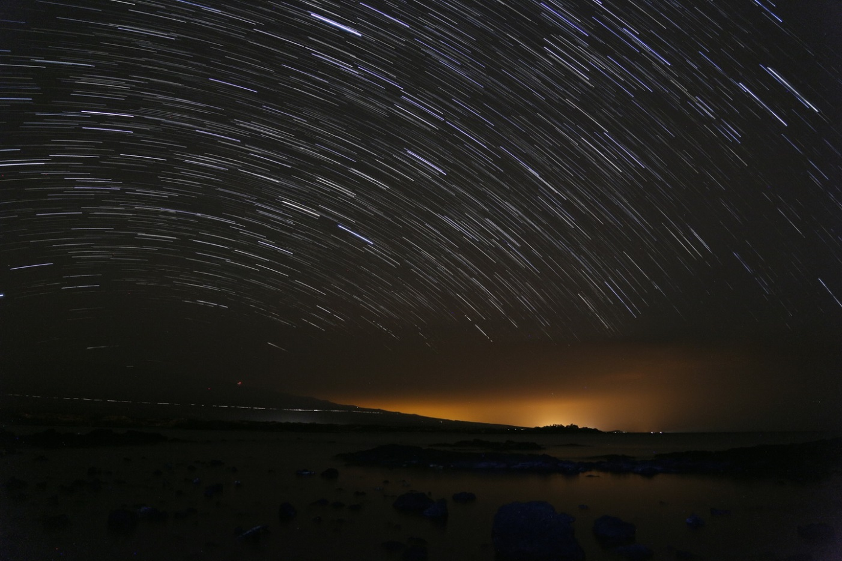
Thank You!
Notes:
That is all, thank you very much.

