Slide 1
Six NASA Funded Science Archives at Caltech/IPAC
Infrared Science Archive (IRSA).
NASA Extragalactic Archive (NED).
Keck Observatory Archive (KOA).
NASA Exoplanet Archive.
Exoplanet Follow-up Observing Program (ExoFOP).
Exoplanet Investigations with Doppler spectroscopy (NEID) Archive (2020) (Funded by NN-explore ).
Notes:
Challenges for KOA
- Science platforms– priority (Python code in place for the
High-level science products!!!!
Real time ingestions
-

Slide 2
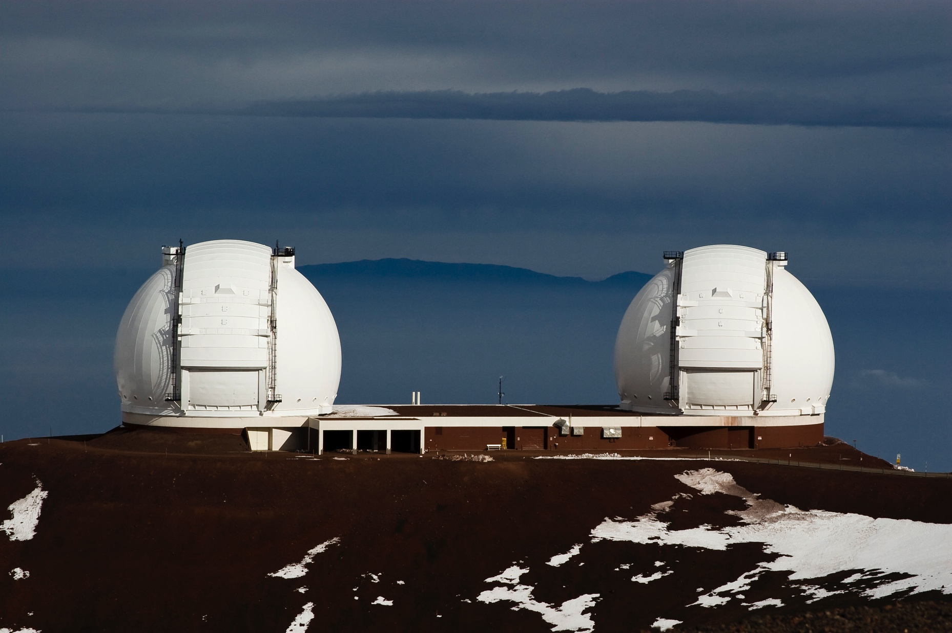
Challenges Facing The Keck Observatory Archive A Collaboration Between the W. M. Keck Observatory and Caltech/IPAC-NExScI.
G. B. Berriman, C. R. Gelino, M. Kong, A. C. Laity, M. A. Swain.
(Caltech/IPAC-NExScI)
M. Brown, J. Mader, J. Riley, L. Rizzi.
(W. M. Keck Observatory)
Notes:
Challenges for KOA
-

Slide 3
KOA is the archive for all WMKO data
The Keck Advantage: “The Observer Owns The Night” data not intended for archiving.
KOA opened for business in 2004.
Focus on creating coherent, consistent data sets for each instrument.
Archives raw data for all 12 WMKO instruments since 1994 (55 TB).
Creates optimum set of calibration files and browse quality reduced products.
https://koa.ipac.caltech.edu

Slide 4
Architecture of Data Flow

Slide 5
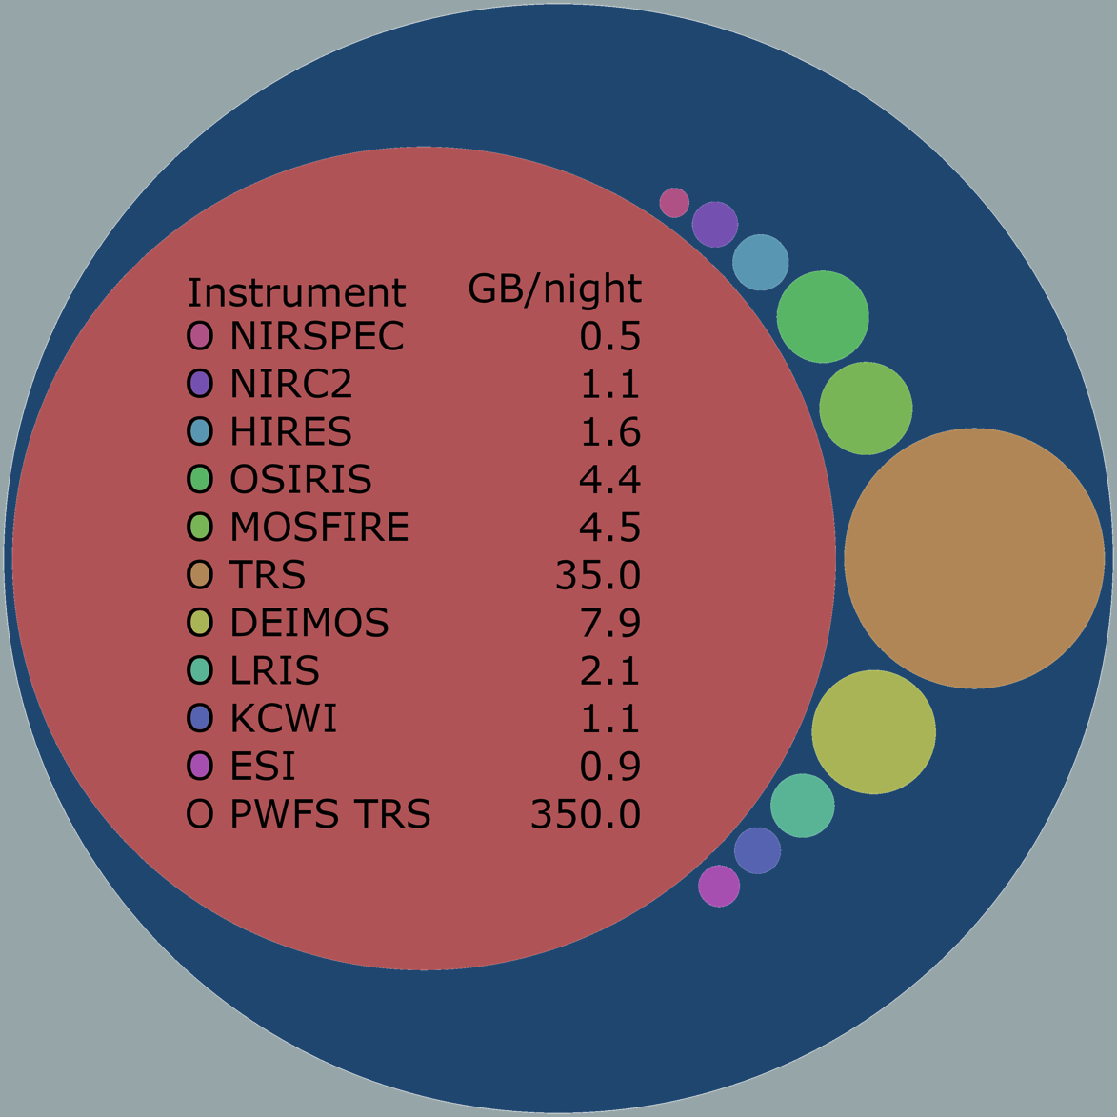
The Challenges … All Within Resource Constraints
Modernization of H/W and S/W architecture and end-user services.
Integration of KOA into Observatory operations.
Real-time ingestion of level 0 (raw) data and creation of level 1 products.
Time Domain and transient astronomy. Multi Messenger Astronomy (MMA) follow-up.
Support for contributed science-ready products.
AO community has requested access to AO-telemetry data for NIRC2, OSIRIS.
Notes:
-

Slide 6
A Bottom-Up Approach
Begin with hardware, OS and archive software…
Replace old servers running Red Hat and Solaris with CentOS virtual servers.
Deploy new Python based software architecture at WMKO and NExScI.
New architecture at NExScI will be API-based.
Then comes real time ingestion and integration with observatory….
… and reduced products:
Observatory will deploy and support Python data reduction packages.
KOA is an active participant.
Support testing and evaluations.
New DRPs will have automated mode to enable continued ingestion of reduced products.

Slide 7
KOA Architecture - WMKO
CSH and IDL-based in the dark depths of time.
2017: Redesign using object-oriented Python.
Subclasses define instrument differences.
Easier operations: sub-modules can be invoked individually.
Easier maintenance: changes to instruments are isolated.
2018: First new instrument archiving deployed in Python.
3 converted from IDL.
Remaining instruments by end of 2020.

Slide 8
NExScI End User Services
Web-based search engines and Solar System Search Service.
Table of released programs (web, CSV, IPAC format).
SIAP v2 Program Interface.
All built atop the Science Information System developed for IRSA – C, Java, Javascript.

Slide 9
The Future of KOA End User Services
New architecture will be API based.
Built on top of a lightweight TAP server written in Python.
DBMS-agnostic as far as is possible.
Deploy KOA on a Science Platform:
Astroquery-compliant Python client interface.
Tight integration of KOA data access and data reduction pipelines.
Custom Python clients invoke a Precision Radial Velocity (PRV) pipeline for HIRES data.

Slide 10
Things That Have Not Gone Quite Right!
These are things since the archive inception that have not gone quite as expected:
Did not support telescope assigned file names … very slow take-up by Keck PIs.
Slow to develop modern interfaces and more scalable end-user services because of emphasis on ingesting all the data.
Very little take-up of SIAPv2 program interface.
Tried to develop DRPs ... but actually out of scope for KOA.
... But none have been disastrous!

Slide 11
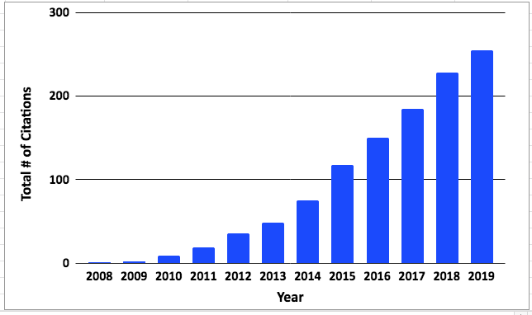
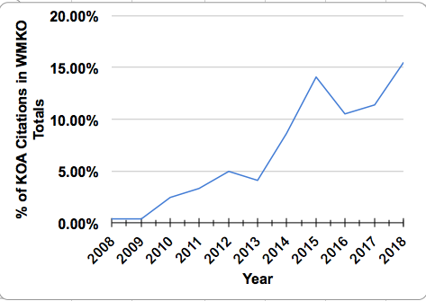
Public Access to a Giant Private Telescope
KOA marries WMKO’s expertise with instrumentation and observatory operations with IPAC’s expertise with data management and archiving.

Slide 12
Back Up Material

Slide 13
KOA Hardware - WMKO
Move from Solaris to CentOS Linux virtual servers began 2015
Two of the 10 active instruments to be deployed on CentOS

Slide 14
KOA Hardware - NExScI
Current hardware – ready to replace.
Dell Power Edge R720 servers for development, testing, operations and ingest
Shares 100 TB disk space with Exoplanet Archive and NEID archive.
Sun Server X3-2L database server
Oracle DBMS
Giving some thought to a No-SQL database

