Slide 1
Subaru/Hyper Suprime-Cam Data Archive System at NAOJ
Hisanori Furusawa
National Astronomical Observatory of Japan (NAOJ)
Astronomy Data Center (ADC) /Subaru Telescope

Slide 2
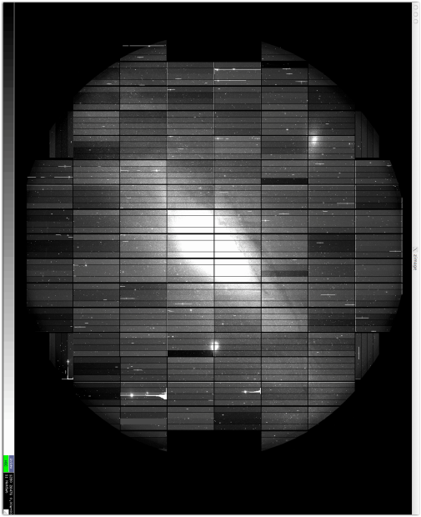
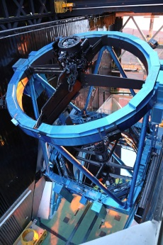
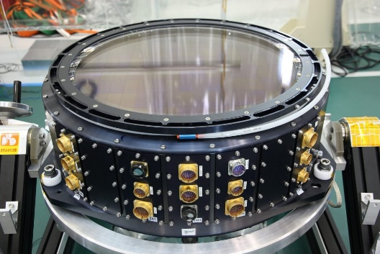
Hyper Suprime-Cam at Subaru Telescope
Workhorse Optical Imager
2014.3 – offered to general use
Wide-field: 1.5 sq.degree
Data size: mosaiced 112 CCDs
→ 2GB / exposure
Data rate: 300-400GB / night
→ 100TB / big survey
→ 1PB products/ data release

Slide 3
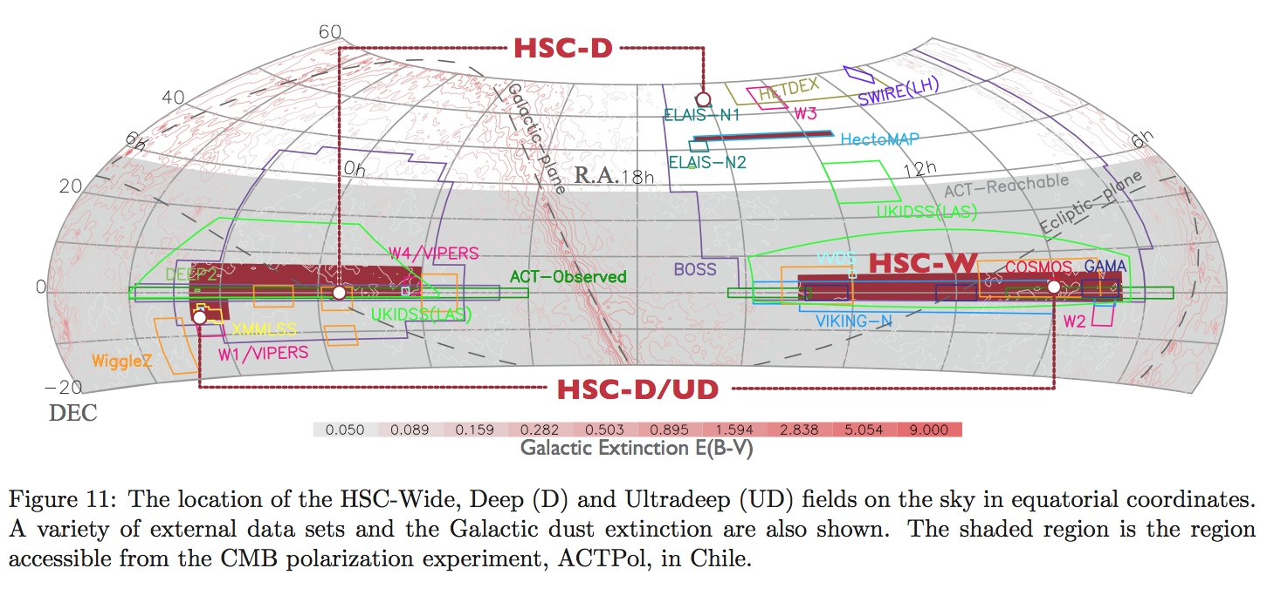
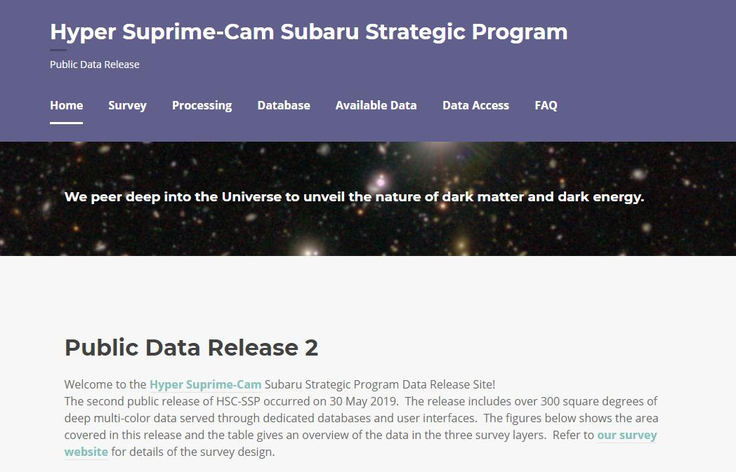
Subaru Strategic Program (SSP) with HSC
Multi-band imaging surveys (grizy + a few narrowbands)
Period: 300 nights (2014.3–present; 5 years) + compensation?
Area: 1400 sq. degree fields around equator
Data volume: File:1PB file, DB:20TB (coadd)/200TB(ccd)
Possible extension: PFS, Euclid, WFIRST?, …
Intern’l project: Japan (NAOJ, K-IPMU etc), Princeton, Taiwan
NAOJ: data processing and data archives with raw/processed data
https://hsc-release.mtk.nao.ac.jp/
Anyone can register & get access

Slide 4
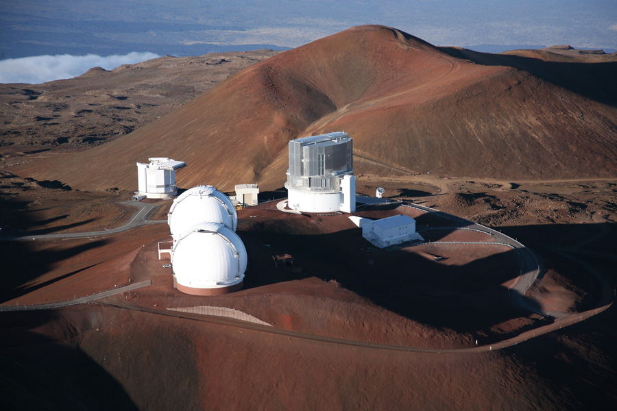
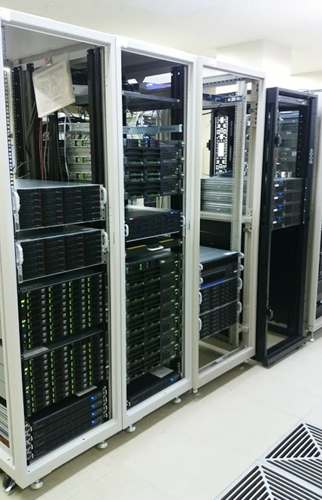
Data Flow and Entire System Structure (Subaru Telescope + Astronomy Data Center (ADC)
Raw data archive
Science production
Science archive
Domestic data
Raw Data Archive to General Users
(SMOKA)
Multi-band data
JVO
HSC @
Subaru Telescope
Users
HSC
OnsiteQA System
Multi-wavelength Data Analysis System
for general users
Subaru
Raw Data Archive
(STARS)
Subaru
Raw Data Archive Mirror
(MASTARS)
1Gbps
HSC-SSP
Data Processing Cluster
HSC-SSP
Science Archive
(Internal SSP, Public)
Hilo/Hawaii
Mitaka/Japan

Slide 5
Hardware of HSC System
In-house maintenance
Under rental contract
On-premise storages + Intel Xeon(Broadwell) CentOS/RHEL servers
Production – PC clusters + Lustre & GPFS (Spectrum Scale)
Archive – RAID(FileServer:6, DB:1+0) storages + NFS with XFS/LVM
16core@3.2GHz,32GB
8core@2.5GHz
16GB
16core@3.2GHz,32GB
LTO8
0.5PB
500TB
NFS IPoIB (InfiniBand)
FS
WEB01
Internal DR
PROXY1
500TB
WEB02
mirror
Ethernet LAN 1GbE, 10GbE
FS
Internal
DR
FS
500TB
60TB
Internal DR
FC
DB01
x 8
60TB
DB05
850TB
WEB03
Public DR
DB02
mirror
FS
PROXY2
8TB
WEB04
mirror
DB03
60TB
Public DR
FS
750TB
Public DR
Testing:
Distr. DB
MR
DB04
60TB
FS
mirror
500TB
Firewall
16core@3.2GHz,256GB
SAS

Slide 6
Services and Software Stack
Catalog Archive System
Extraction of source information with SQL (CSV, Sqlite3, FITS formats)
SQL jobs queueing
Schema browser
SW) PostgreSQL 10.9 parallel query, Python, Ruby on Rails, JavaScript
Data Archive System
Search and download FITS images and intermediate files
Image cutout in a specified region
SW) Python CGI, JavaScript
Interactive image/catalog viewer (hscMap)
Display pseudo-color images
Overlay catalog info
Other useful small analyses
SW) JavaScript
APIs for connecting CAS
SW) Python (psycopg2, data transferring modules)
Authentication & Access control system
SW) In-house Apache mod_python module for LDAP auth, Python CGI (DB)

Slide 7
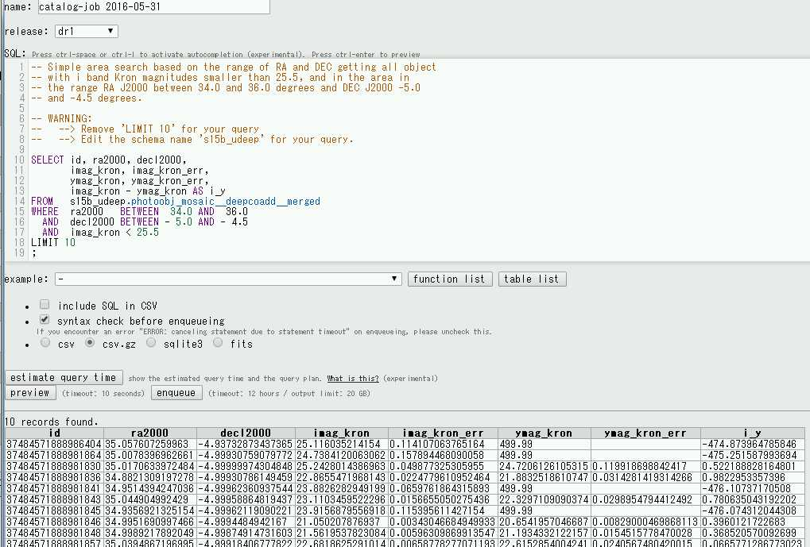
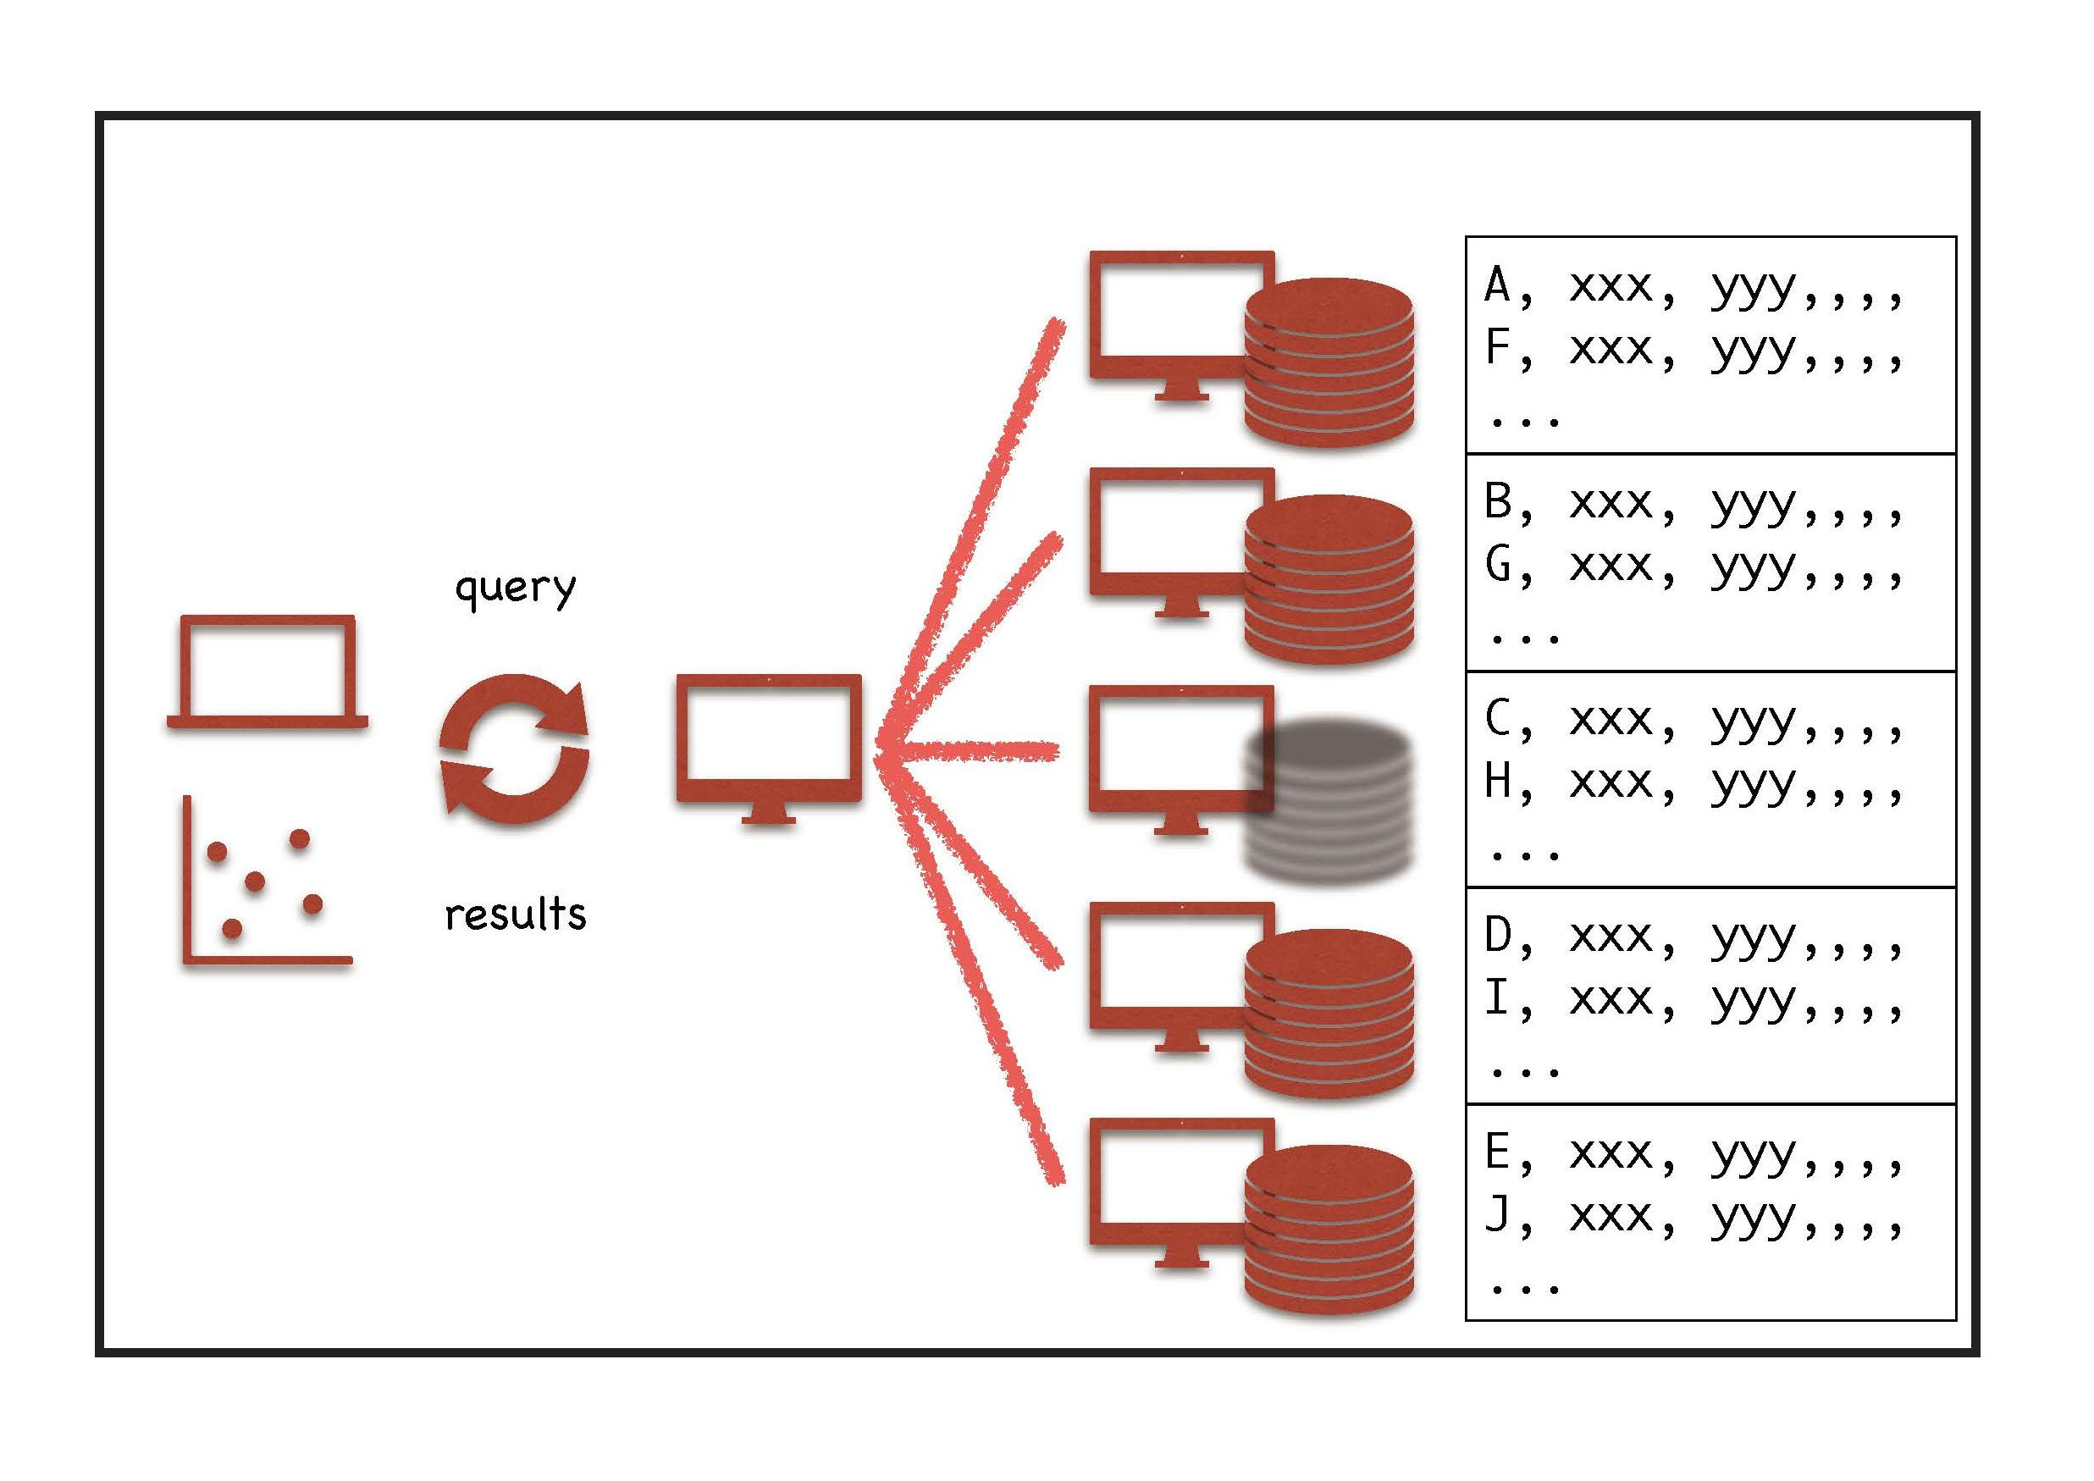
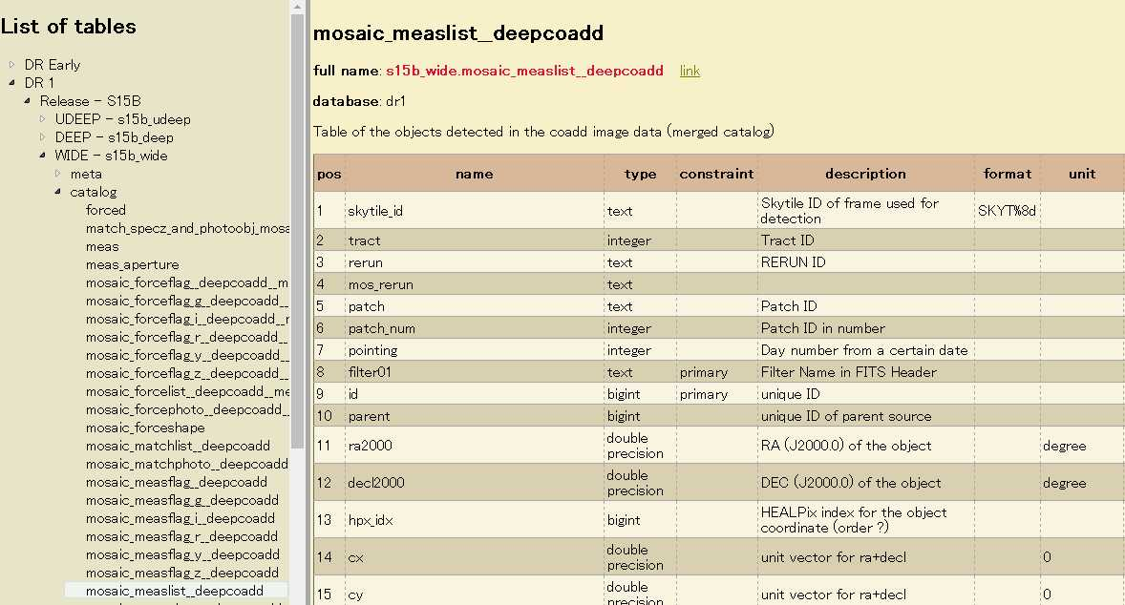
Catalog Archive System
Accepts SQLs
Provides science-ready catalog information in CSV, Sqlite3, FITS formats
User queries queued and executed by the system
Trials of improving performance
distributed DB or MR etc
Query Interface
Schema browser
User
Query
Result
Faster returns by a factor of 12
Single node DBMS: 27m20s (1640s)
Citus over 4 nodes: 4m29s (269s)
Citus over 8 nodes: 2m12s (132s)
ObjectId
Coordinates
Magnitude stuff

Slide 8
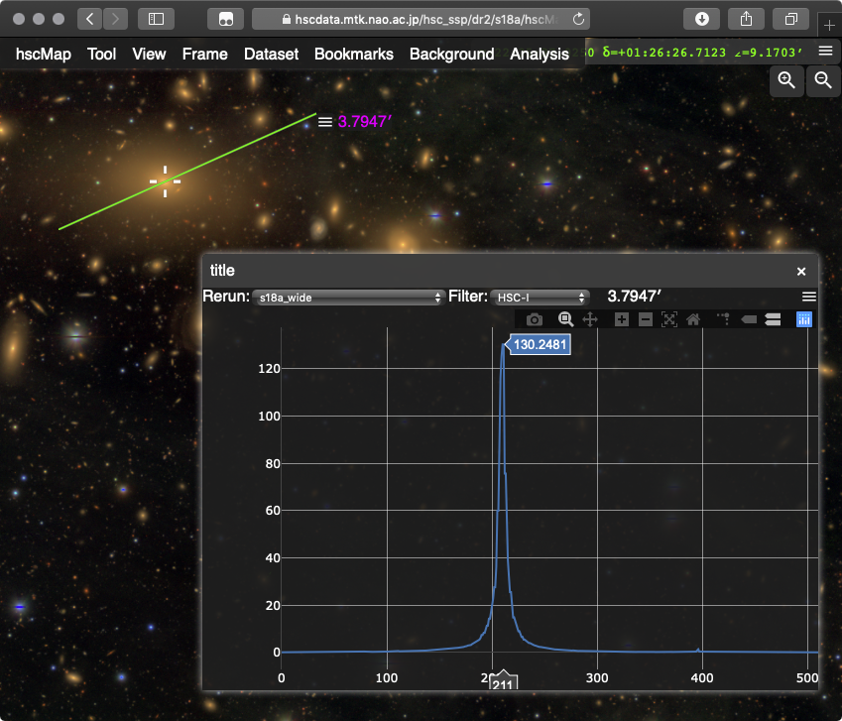
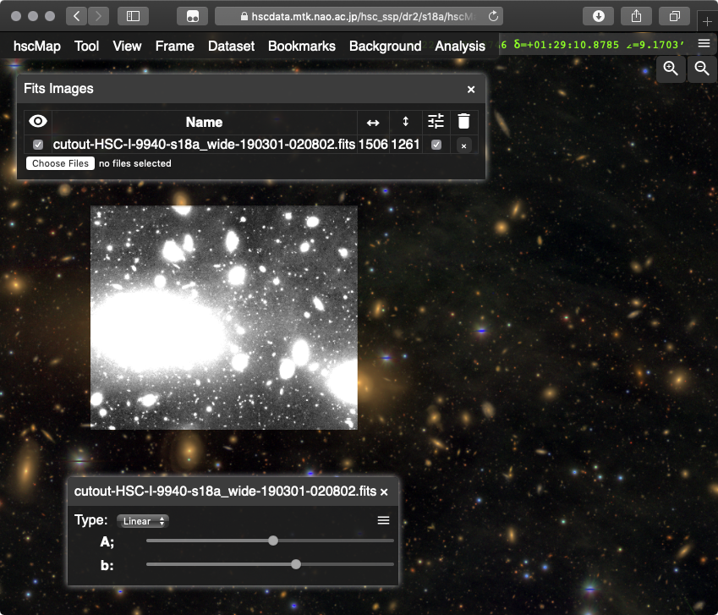
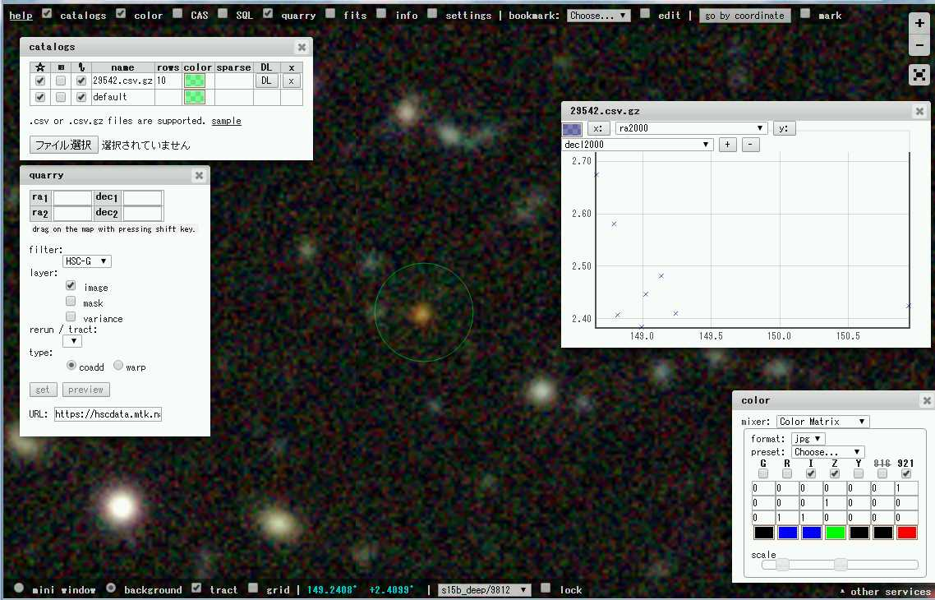
hscMap
Web application for viewing images & catalogs
Connecting to CAS, Overlay queried catalog sources
Draw source profiles
Call image cutout

Slide 9
Current development & bottlenecks (for archive)
Ongoing development or Struggles for:
1) Query performance -- adapting to growing data sets, & better sciences
2) Extension -- for upcoming project (HSC+Prime Focus Spectrograph)
3) HW issues
Improving Database design & Performance
Adapting to Schema evolution ← pipeline is growing
Undesired splitting tables due to limitation of DBMS (64KB or 1600cols/row, & page size)
Adapting to demands for access control of various user groups
Applying SSD for database, index spaces, but was unstable.. resolving today?
Testing parallelization & distribution of DB
Wide (thousands of columns) and Long (billion of rows) tables
Conventional single RDBMS on a single server is not responsive enough
Splitting & partitioning big tables into small sub-tables
Citus (sharding w/distr. DB), In-house MR+columnar tables, but can’t cover all use cases ..
Overhead for outputting results for gathering & formatting result into FITS, CSV, Sqlite3
Notes:
S18A:file 470TB+47TB PDR2 row 7.1億=700million(5band included), 最終CCD400億＝40billionｘバンド行、 coadd5.5億=0.5billionxバンド行

Slide 10
Current development & bottlenecks (for archive) 2
Extension for the upcoming project (HSC+PFS; Much deeper SDSS)
User environment (Docker, SDSS’ CASDB)+ APIs/Tools to connect products
Compute@SciServer w/ JHU, Princeton, K-IPMU, & In-house dev. of container+K8S service
Load-balancing -- TBD
HW Platform
Likely shortage of storage (both files, DB)
Data model evolution ≫10 millions of 1kB-10GB files ← pipeline is growing
Generations of releases ← project (w/ ground-based telescopes) is extending
Difficulty updating and maintaining HW
moving the data & keeping functionality of such a heterogeneous system
Overhead of transferring/sharing data between processing and archive systems
Difficulty having permanent backup plan
to be addressed based on priority (access frequency), lifetime.., but data are inflating
Compression, Writing to tape, What to do next?
Threatening budget cut
Sharing the disks across currently-independent but related services
On-premise or Clouds? -- archive not only for backup. Difficult effective cost-cut

Slide 11
Concerns
We’re a <10 small team, so man-power (+ budget) limited & overwhelmed
Data-intensive projects approaching (HSC+PFS/Euclid/WFIRST?, LSST, & beyond)
But, importance of the data management & team for it seems less acknowledged by the executives?
Failing to address our original goals, especially seeking:
Optimal DB design for the final products
Want to ingest not only coadd catalogs (present) but all epochs for temporal sciences (goal)
Present: 700 million rows
Finally: 3(coadd)—200(ccd) billion rows or 200TB DB XX
Secure Backup Plans
Hopefully, data validation and improvements more thoroughly done for way better & cutting-edge sciences

