Slide 1
CSIRO ASKAP Science Data Archive
Minh Huynh & James Dempsey| 5 August 2019

Slide 2
ASKAP – Australian SKA Pathfinder
36 dish radio interferometer
12 metre
Diameter steerable parabolic dishes with roll axis for high dynamic range imaging
2.5 GB/sec
Data arriving to Pawsey
5 PB/year
Data archived to CASDA
300 MHz
Instantaneous bandwidth operating between 700 – 1800 MHz
16200 channels
High spectral resolution (~18.5 kHz)
~30 sq deg
Field of view from 36 beams using phased array feeds
Fast survey radio telescope with very high data rates

Slide 3
ASKAP Data
Calibrated visibility data files
archived for all continuum data (as 300 channels x 1 MHz)
Images (2D) and image cubes (3D and 4D)
Continuum, spectral line, polarisation
Moment maps, spectra, cubelets
Catalogues
Image: Giant radio galaxy in G23 (Seymour et al. 2019 submitted)

Slide 4
Deployment

Slide 5
Infrastructure
Pawsey Supercomputing Centre
Two production servers:
4x Intel(R) Xeon(R) CPU E5-2650L 0 @ 1.80 GHz
32 cores total
128 GB RAM
Drives:
Archive: 256 TB DMF managed CXFS
Access: 128 TB CXFS
Application: 256 GB XVM
Lustre: 3.1PB shared with Galaxy
Tape:
2x 12 frame Spectra Tfinity tape libraries (20 PB)
Network:
Infiniband

Slide 6
Software
Product | Role
Java | Primary server language
PostgreSQL (+PGSphere) | Primary database
Elasticsearch, Healpix | Search engine
Aladin Lite, HiPS, Catalogue HiPS, MOC | Map displays
NGAS | Storage management
Montage, python | Image generation
Data Management Framework (DMF) | Tape/disc management
Slurm | Workload manager
Jenkins, Gradle, Bitbucket (git) | Continuous Integration

Slide 7
CASDA VO Tools
Built to be used anywhere
Remote database access via TAP, SCS, Datalink, SIA2, SSA
Requirements:
Java 8
Postgres database (pgsphere optional)
Web container (e.g. tomcat)
Interactive configuration
Discover table structure, create metadata
Config stored in yaml file which can be edited

Slide 8
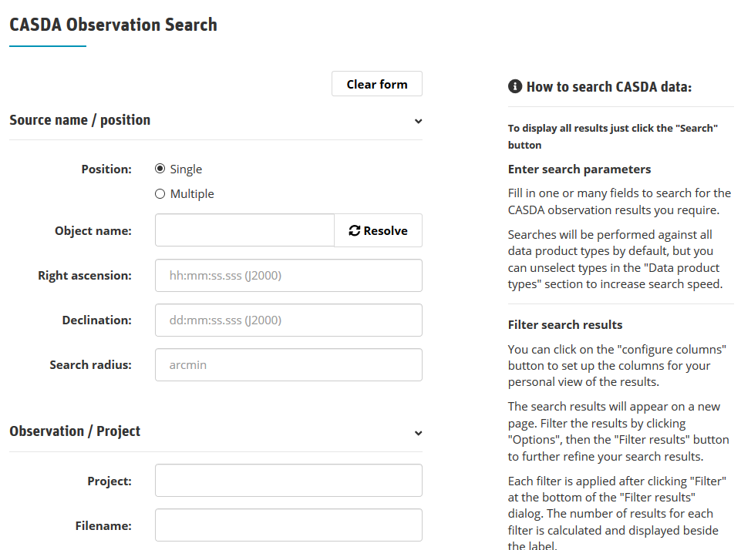
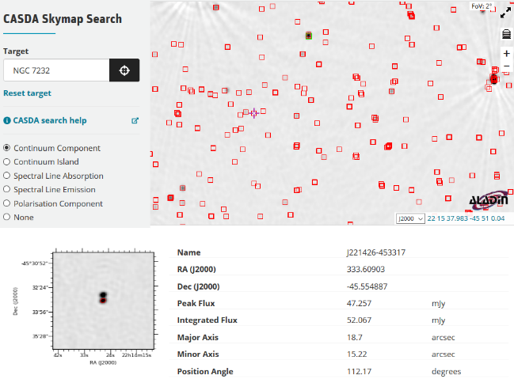
Available Services
Search using various parameters, e.g. project, cone search
Download full or partial ASKAP data products
Interactive Skymap search with Aladin-lite interface
User upload of value-added science catalogues and image cubes
Digital Object Identification (DOI) for all datasets
_{Virtual Observatory Services:}
_{Table Access Protocol}
_{Simple Cone Search}
_{Simple Image Access}
Server-side Operations for Data Access
Simple Spectral Access Protocol
Discover data via IVOA compliant tools such as TOPCAT
Scripted access to data via python scripts

Slide 9
Services Under Development
OAuth2 authentication against other ASVO systems (e.g. Data Central)
Astroquery - extend CASDA module
TAP Upload
Website with science focused system help

Slide 10
Blockages / Things we had trouble with
OAuth2 with TAP
How to make this work with non web tools
Transfer speed
TAP Upload has been challenging
UWS 1.1 requires much more interaction with the request
On the fly parsing of votable and creation of tables
Data access side is still developing
Notes:
TAP upload - Two starts before making progress
UWS 1.1 - needed to wire this in with our spring framework
Parsing and storage of tables - much of the pieces were there in our app but had to be repurposed and brought together
Early days on data access side, still don't have a good idea of what the astronomers want here.

Slide 11
Thank you
CSIRO Astronomy and Space Science
Dr Minh Huynh Team Leader, ASKAP & Archives
+61 8 6436 8696
Minh.Huynh@csiro.au
CSIRO Information Management & Technology
James Dempsey Senior Developer, Information Services Applications
+61 2 6214 2912
James.Dempsey@csiro.au

